Slide 1
ClearSight Training:
Test Administration & Monitoring
2022-2023
Notes:
Welcome to the Test Administrator & Monitoring training module. This presentation describes the Test Administrator (TA) Interface that you will use to administer online tests.

Slide 2
ClearSight Support Resources
ClearSight Portal
Training slides
User manuals
Quick guides for common actions
and much more!
ClearSight Help Desk (via “Contact Us” page)

Slide 3
Agenda
Secure Browser Testing vs. Public Browser Testing
Types of Test Sessions
Logging In to the Test Administration Interface
Creating an Active Proctoring Test Session
TA Interface
Creating an Upcoming Proctoring or Assignment Test Session
Student Login via Secure Browser or Public Browser Links
Monitoring a Test Session

Slide 4
Secure Browser Testing vs. Public Browser Testing

Slide 5
Secure vs. Non-Secure Testing
ClearSight assessments are flexible in that they can be administered through either:
A Secure Browser application available for download on our ClearSight Portal
An online browser like Chrome, Safari, and Firefox (allowing students to use personal devices)

Slide 6
Secure Browser Testing
The ClearSight Secure Browser is available for download on the ClearSight Portal.
The Secure Browser will prevent students from having other applications open on their testing device while attempting a ClearSight assessment
The Secure Browser should be downloaded by your technology support staff on all school-owned devices that students may use for testing
The Secure Browser is not required for testing, but it is the most secure way to administer a test
Secure Browser testing requires that students manually input the Test Session ID for their specific test session. Proctors will need to share the Test Session ID with all students testing on the Secure Browser.

Slide 7
Public Browser Testing
For added flexibility, ClearSight assessments can also be administered through a standard internet browser like Chrome, Safari, or Explorer.
Students access their test session through either:
A direct Test Session Link
A direct Test Session link is created automatically for each Test Session, and can be access from your TDS Dashboard. This direct link includes the Test Session ID pre-populated for your students
The generic Student Login Link
The Generic Student Login link can be shared or bookmarked on testing devices for easy access to the student login page
The generic link requires students to manually input the test session ID provided by their Proctor
Notes:
We will share more about Student test access later in these slides, as well as in our Student Interface Training slides also found on our ClearSight portal.

Slide 8
Types of Tests Sessions

Slide 9
Types of Test Sessions
Once logged in to the Test Administration System, you will be presented with 3 different options for creating your test session:
Active Proctoring – synchronous testing that requires a live proctor NOW
Upcoming Proctoring - synchronous testing that requires a live proctor in the FUTURE
Assignments – asynchronous testing that does NOT require a live proctor

Slide 10
Types of Test Sessions
Active & Upcoming Proctoring sessions generate a TA Interface that must be monitored during the administration. This TA Interface allows the test administrator to admit students into the test session and track their testing progress.
Assignments provide flexibility for students to take a test on their own with no test administrator admitting them to the test session or monitoring their testing progress.
Notes:
Once you have made a decision regarding the type of test session you want to create, simply click the appropriate tab and then “Start a New Session”. We will demonstrate an example using the Active Proctoring option.

Slide 11
Proctored vs. Assignment Sessions
Feature | Proctored | Assignment
Dashboard to track test/student status | ✔ | ---
Asynchronous (students can take test at different times) | --- | ✔
Synchronous (students must take test with a live proctor) | ✔ | ---
Can be prescheduled | ✔ | ✔
Can have multi-day window | ✔* | ✔
TIDE reports show current status | ✔ | ✔
Student can use Secure Browser on school-owned supported device | ✔ | ✔
Student can use system-generated** web link on school-owned or personally-owned supported device | ✔ | ✔
Print-out stimulus or item during testing | ✔ | ---
*The test session must occur continuously within the designated test window — a session cannot be started one day and completed the next. **Web link must be provided to the student by the test administrator.

Slide 12
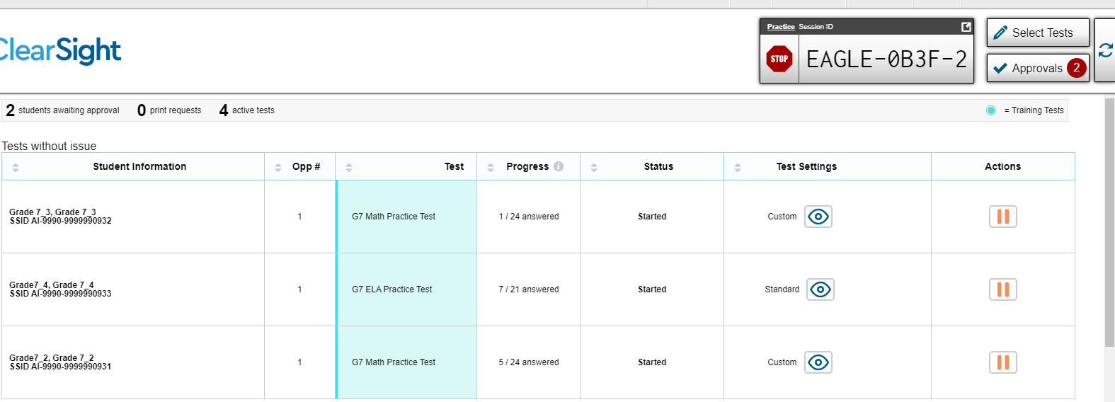
Proctored Session TA Interface
Below is an example of the TA Interface a test administrator sees during a Proctored Session.
Approvals, Progress, Status, Test Settings, and Actions can be tracked from this screen.
Notes:
Read slide as you click

Slide 13
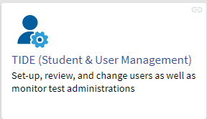
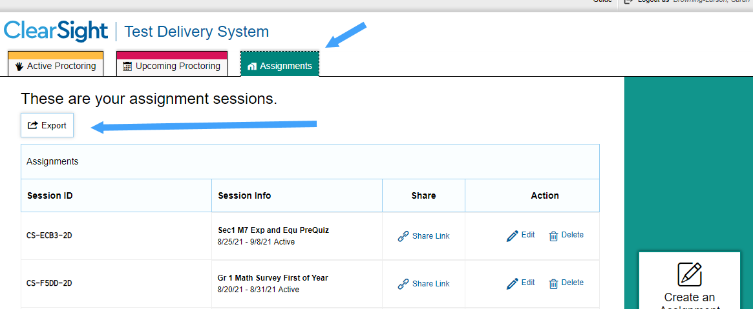
Assignment Session Dashboard
Test and student statuses for Assignment sessions can be viewed through the Test Status Report in TIDE.
Your full list of Assignment Sessions can also be exported directly from your TDS Assignment dashboard for tracking purposes.

Slide 14
Logging In to the Test Administration Interface
Notes:
The TA Interface is used to create and manage test sessions that students join to complete online tests. We will begin with detailed instructions on how to log in to the interface, followed by a detailed review of each feature.

Slide 15
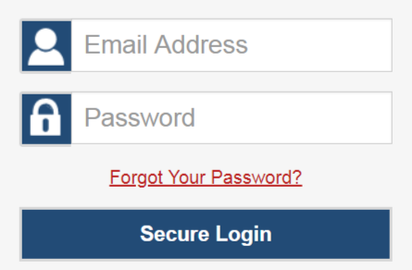
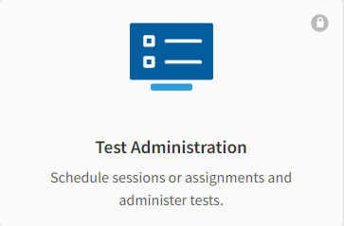
Logging In to the TA Interface
Login Screen
Test Administration Card
Notes:
To log in to the TA Interface, go to the ClearSight portal. Select the Actions: Get Started card. Next, select the Test Administration card. Enter the email address associated with your Test Information Distribution Engine (TIDE) account and your password. Then select Secure Login.

Slide 16
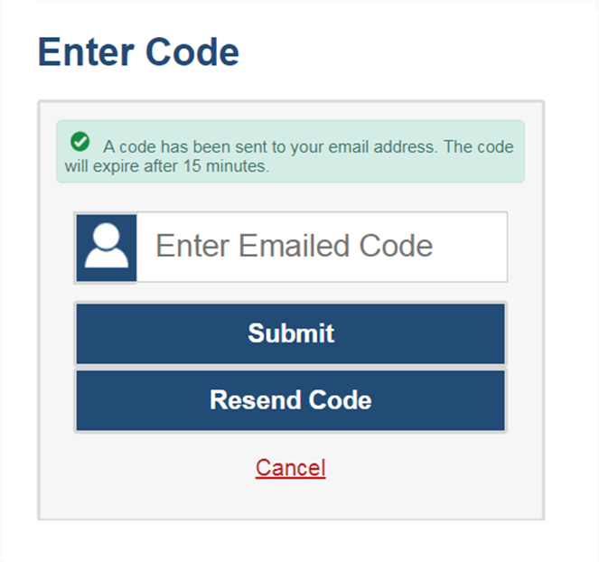
Logging In to the TA Interface (continued)
The system has an authentication process that will be triggered when you log in from a different device or browser, or after clearing your browser’s cache.
If you see this screen, an email containing the code will have automatically been sent to your email address.
Enter the code and select Submit.
If you need the code resent, select Resend Code.
Notes:
When logging in to the system using a new device or browser, or after clearing the cache on a previously used browser, you will see an Enter Code page.
If you see this screen, you will need to enter the code on this page within 15 minutes of receiving the email. If you do not receive a code or do not enter the code within the 15-minute time limit, select Resend Code. Select Submit after entering the authentication code to access the system.
Next, we will walk through how to create a test session.

Slide 17
Creating an Active Proctoring Test Session
Notes:
The first step in administering any test is to create a test session.

Slide 18
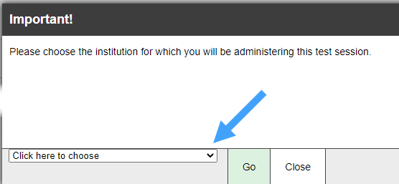
Creating a Test Session
Notes:
Once you login to the Test Delivery System, you will be met with your TDS Dashboard with tabs for Active, Upcoming, and Assignment test sessions. The Active tab will always be the default landing page, and if applicable, you will see a table that lists any other Active sessions you are currently monitoring. If you are not actively monitoring any other session, your table will be blank.
To start a new Active session, click on the “Start a New Proctoring Session Now” button on the right side of the screen.
Remember, when scheduling an Active session, your students should be ready to begin testing right now.
Once you click “Start a New Proctoring Session Now” , you will be presented with a pop-up window to choose your institution. Select your school and then select “Go”.

Slide 19
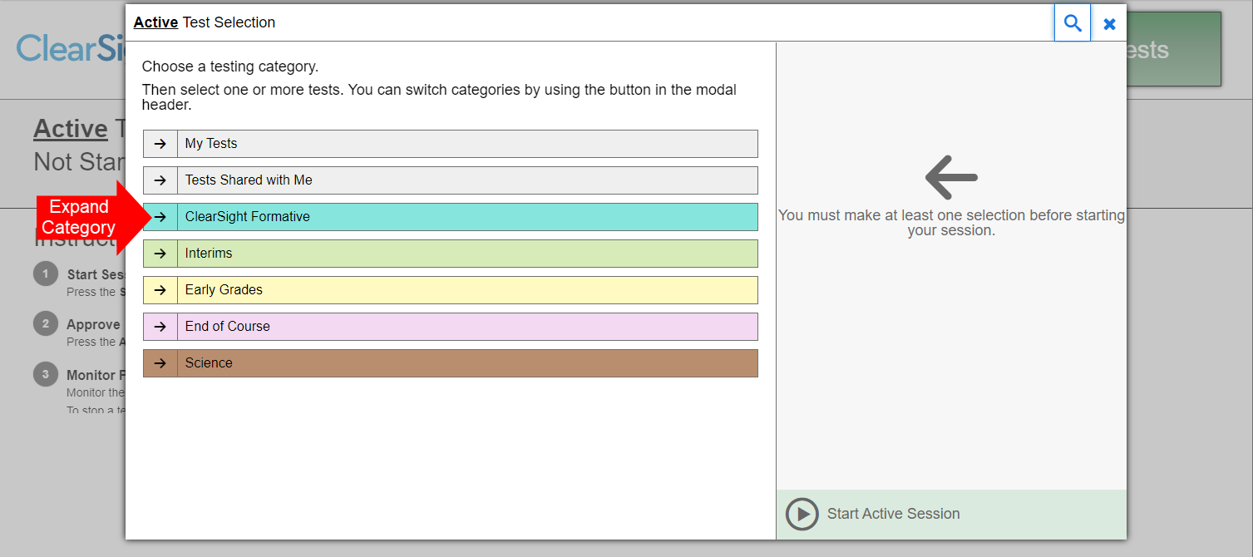
Create a Test Session: Test Categories
Notes:
Once you have selected a session type, the Test Selection pop-up window appears, displaying color-coded test categories such as ClearSight Formative, Interims, Early Grades, End of Course, and Science (if your district has purchase the supplemental Science package). It will also list 2 categories for teacher-authored tests created in the Authoring system – these will be the first two test categories in gray, “My Tests” for authored tests created in your user account as well as “Tests Shared With Me” for authored tests that other users have give you permission to administer to students.
To expand a category and see all the possible tests for that category, select the arrow next to the category name.

Slide 20
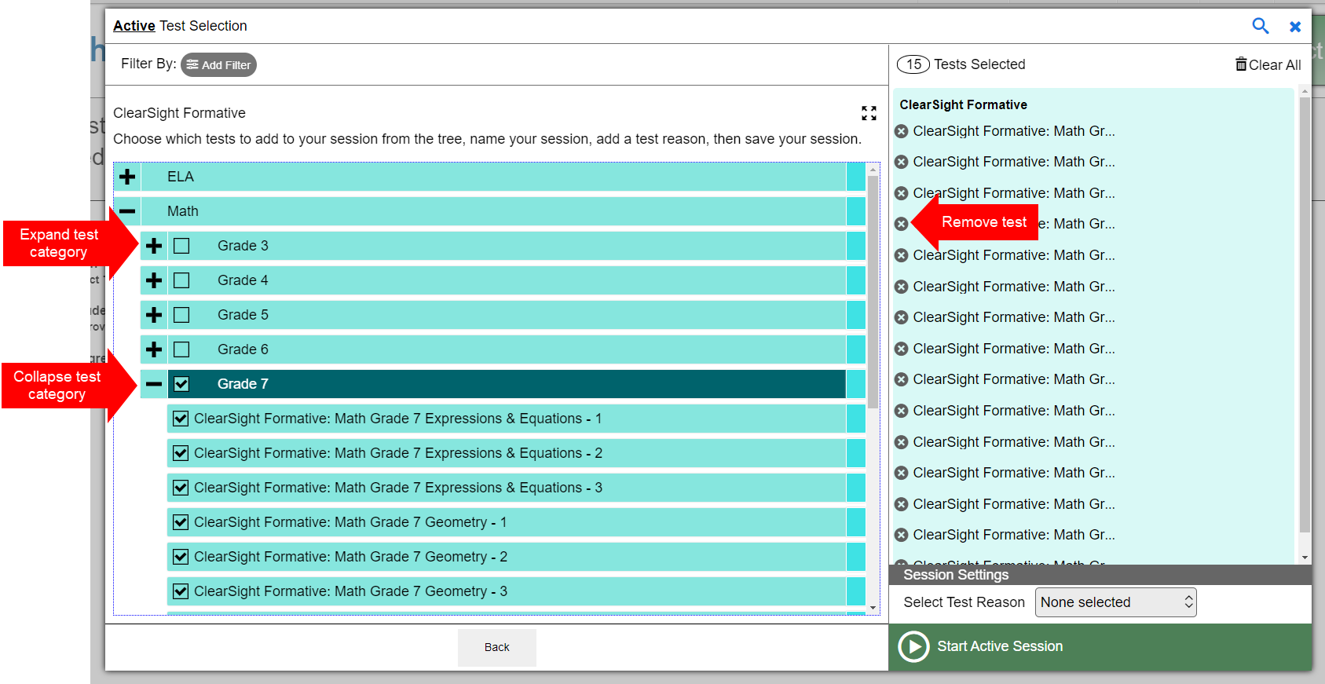
Create a Test Session: Test Selection
Notes:
Once you have selected a test category, you can select the plus sign (+) button next to a test group name to view the tests in that group. To create a test session, select one or more tests to administer, or select the checkbox for a test group to include all tests in that that group. Once you select tests to add to the session, they will appear in the “Tests Selected” column on the right side of the window. If you need to remove a test that you have previously selected, select the “x” button to the left of the test name.
To add tests from a different test category, select the back button to return to the list of test categories.

Slide 21
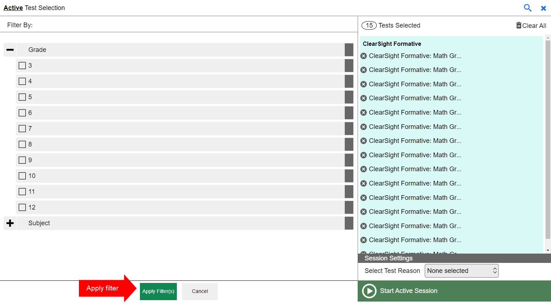
Create a Test Session: Filters
Notes:
You can also filter a list of tests by grade and subject, in order to focus on specific types of assessments. If teacher-authored tests are available, you can filter by custom label and standards, as well. The filters function is especially useful if a large number of tests exists.
To filter a list of tests, first select the Add Filter button and the filters panel will appear. Then select the plus sign (+) button next to the grade and/or subject to expand the category and see a list of available grades and subjects. Mark the checkboxes next to the grades and/or subjects you want to filter by. Your selected filters will appear at the top of the window. If you want to remove a filter, select the “x” button next to the filter you want to remove.
Once you are finished selecting filters, select Apply Filter(s).

Slide 22
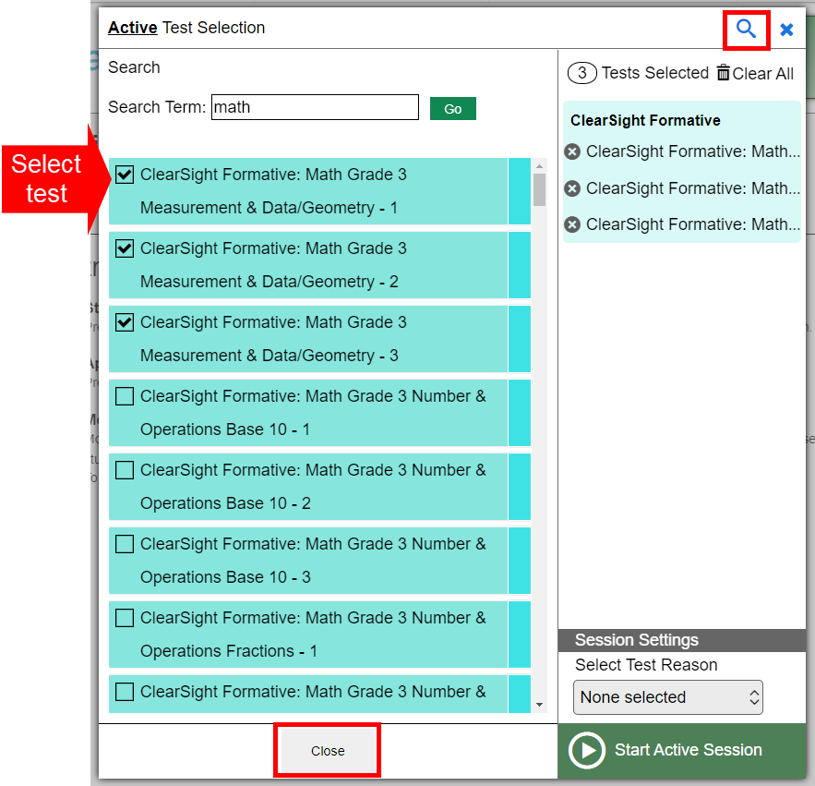
Create a Test Session: Global Search Feature
Notes:
You can also search for specific tests to add to your session by using the global search feature.
To search for tests, select the magnifying glass in the upper right corner of window. On the search panel that appears, enter the full or partial test label in the Search Term field and select Go. A list of tests containing your search terms will appear below. Select the test(s) you want to add to your session by marking the checkbox next to the test name. If you want to close the search window, select the Close button at the bottom of the panel.

Slide 23
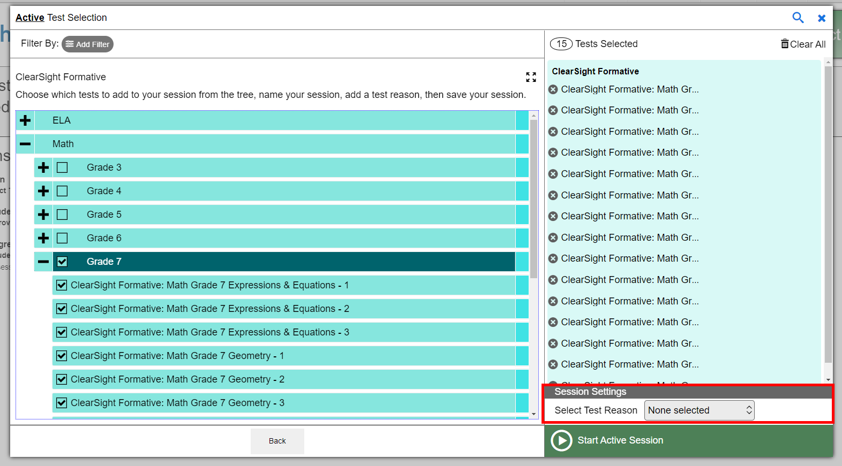
Create a Test Session: Test Reasons
Notes:
Select a Test Reason from the Select Test Reason dropdown under the Session Settings section. From the drop-down list, input a Test Reason from the pre-populated options. These Test Reasons are associated with your tests in the Reporting system and can also be changed later on in Reporting if useful.

Slide 24
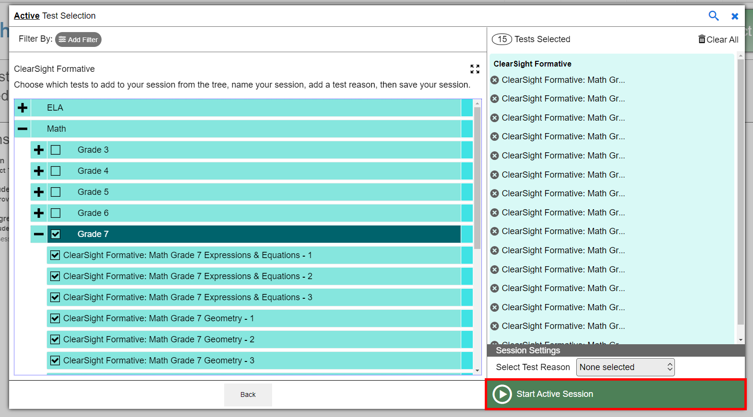
Create a Test Session: Start Session
Notes:
Once you have selected the test or tests you want to add to the session, select the Start Active Session button.

Slide 25
TA Interface
Notes:
Once you have started your test session, you will be taken to the TA Interface.
You will see Instructions in the center of your screen, TA tools in the Banner, and test session information on the top right hand side, including your Test Session ID, and buttons to Select Tests, approve students, and manually refresh the page.

Slide 26
TA Interface - Session ID
Notes:
Once you start a session, the system will automatically generate a unique session ID for this specific test session. The session ID will appear at the top of the TA Interface along with a Stop button.
For students testing on the Secure Browser, this ID must be provided to students in order for them to log in. You may write it on the blackboard or provide it to students using a printed card or similar method. If you do provide students with the information on paper, be sure to collect and destroy it when the session is complete.
You should also note the session ID for your own records. If you accidentally close your browser, entering the session ID will allow you to resume the session. If you do not have this information when you try to resume, you will be unable to do so.
Once students start signing in to the test session, an Approvals button will also appear next to the session ID with a red circle indicating the number of students awaiting Proctor approval to join the test session.

Slide 27
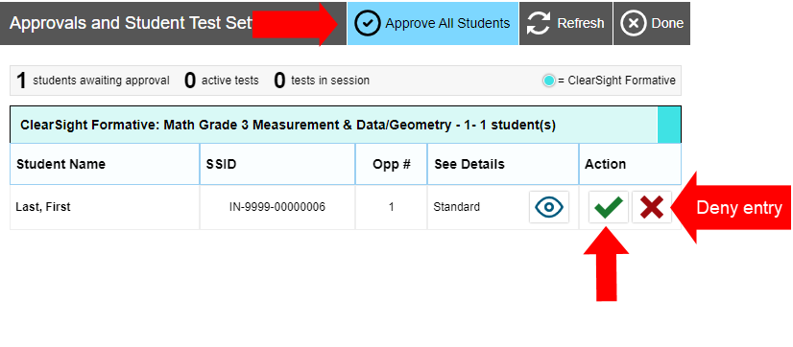
TA Interface - Approving Student Entry
Notes:
Once you start the test session and students log in, you must approve their test settings before they can access their tests. It is very important that you pay close attention to the test name prior to approval to be sure that students have selected the appropriate test. To approve students for testing, select the Approvals button next to the session ID. A list of students will display, organized by test name. You should review the list to make sure that all students chose the correct content area and test. You should also ensure that all the settings for each student are correct. This is done using the Eye button in the See Details column. We will talk more about that in a few moments.
If no changes are needed, select Approve All Students to admit all students to the session. You will see a confirmation message appear after selecting Approve All Students. If a student selected an incorrect test, you must deny that student entry to the test session by selecting the X button in the Action column.
Once you approve students for testing, the Test Session table will appear in the center of the TA Interface, displaying students’ testing progress. We will review the Test Session table in later slides when we demonstrate Test Monitoring.

Slide 28
TA Interface - Denying Student Entry
Deny entry to a test session in these circumstances:
The student is not supposed to enter this session.
The student’s demographic information is incorrect.
The student’s required accommodations are incorrect.
Notes:
Although you can approve all students at the same time, students must be individually denied entry into the test session.
You should deny students entry into the session in these circumstances:
• The student is not supposed to enter this session.
• The student’s demographic information is incorrect.
• The student’s required accommodations are incorrect.
Denying the student entry into the test session will not prevent other approved students from beginning their tests.
If the student’s test settings are incorrect, the settings must be updated in TIDE or the TA Interface before the student takes the test. Contact your School Test Coordinator or District Test Coordinator to have the settings updated. This will prevent resetting the test for the student later. Please note that the changes may not be immediate.
Note that no settings can be changed while the student is actively testing. Once a student begins testing, the language option cannot be changed without resetting the test opportunity. Updates to background color or font size will take effect only after the student logs out and then resumes testing.

Slide 29
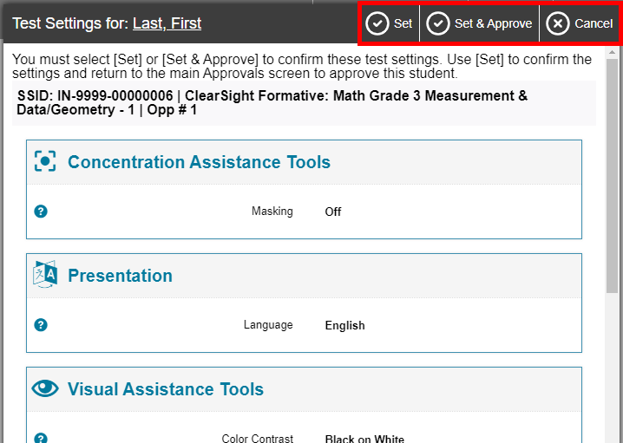
TA Interface - Viewing Student Details
Notes:
If you need to change test settings for a student, select the Eye button in the See Details column. The Test Settings window will appear, which displays the student’s information at the top and various test settings organized by their area of need.
Some test settings can be changed in this window. After adjusting settings, select the Set button to change the settings without approving the student. To both change settings and approve the student for testing, select the Set & Approve button.
Some test settings can be viewed but not changed in this window. These test settings must be set by an authorized TIDE user prior to testing. See the TIDE User Guide for more information.
Note that the Test Settings window may not appear exactly as it is shown here, depending on your user role and permissions.

Slide 30
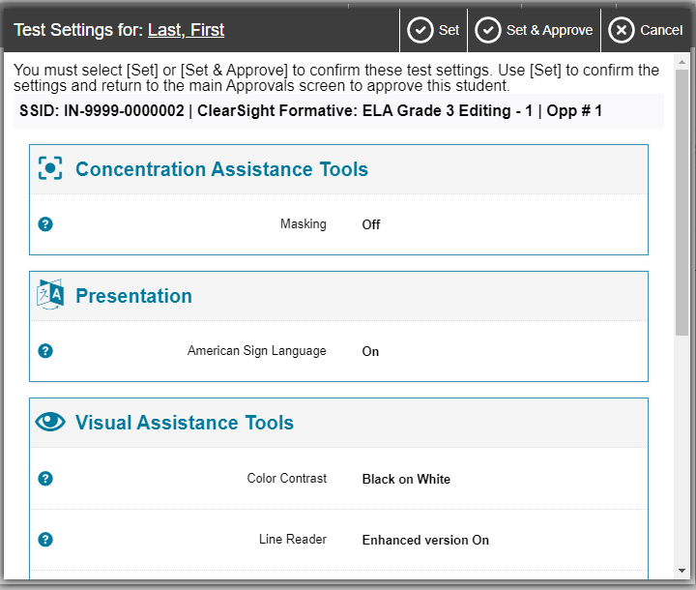
TA Interface - Confirming Student Details for Interim and Formative Tests
Notes:
Student settings cannot be changed within the TDS interface when administering Interim or ClearSight Formative assessments. These settings can only be modified in TIDE to ensure students have the appropriate accommodations available to them on all ClearSight tests.
Student settings should be carefully reviewed here, and if it is determined that a change is needed, have the student Log Out of their test session, and ask your School Administrator to modify the student’s information in TIDE before administering the test to this student.

Slide 31
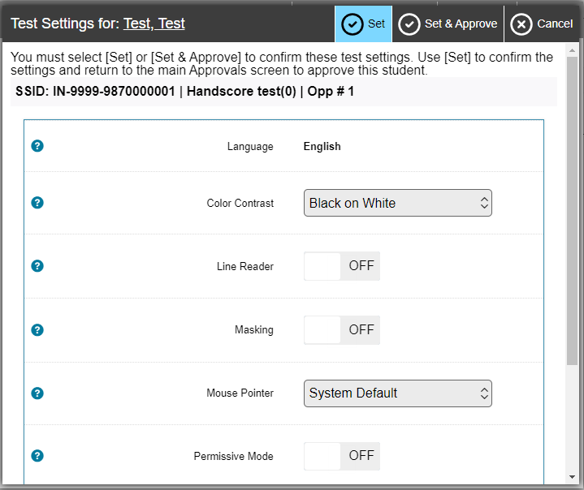
TA Interface - Editing Student Details for Authored Tests
Notes:
On the other hand, student settings CAN be modified when administering Authored assessments. You can modify the available test settings for individual students directly within the TDS interface before approving them to join the test session.
However, if you find that additional settings are required for a student outside of what is available in the TDS interface for Authored tests, have the student Log Out of their test session, and ask your School Administrator to modify the student’s information in TIDE before administering the test to this student.

Slide 32
TA Interface - Banner
Notes:
In the banner at the top of the window, you will see a set of buttons and your username.
Select Student Lookup to search for student login information and verify that the student’s login credentials are correct.
Select Approved Requests to view a list of student print requests that you approved during the test session.
Select Print Session to print a screenshot of the TA Interface.
Select Help Guide to access additional information about the TA Interface.
Select Alerts to view messages.
Select the Logout button to exit the TA Interface.

Slide 33
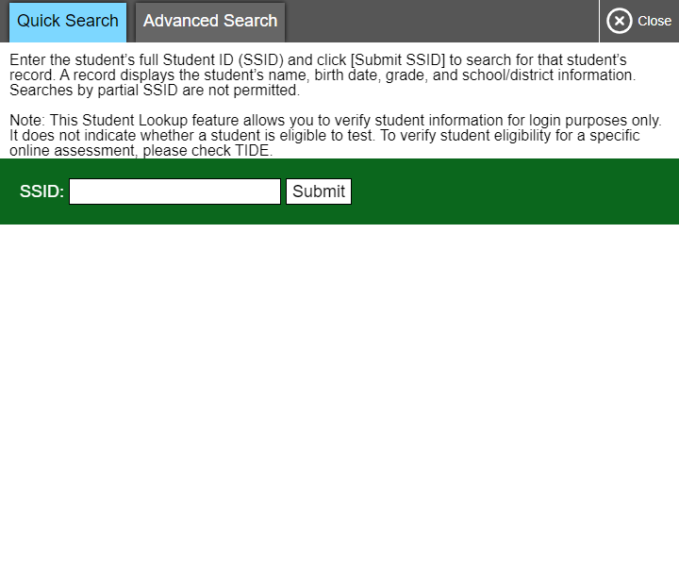
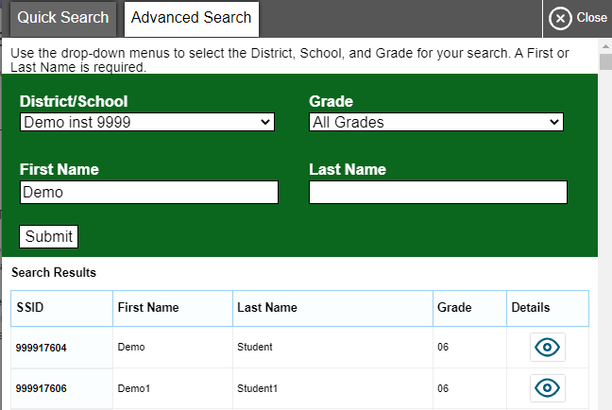
TA Interface - Student Lookup
Quick Search
Advanced Search
Notes:
If a student is having trouble logging in, use the Student Lookup feature to verify that the student’s login credentials are correct. You can use either the Quick Search or Advanced Search option to view the information entered for the student in TIDE. With Quick Search, you simply enter the student’s state-assigned student ID and select the Submit button. Advanced Search allows you to narrow your search using several filters, including District/School, Grade, First Name, and Last Name.
When using Quick Search or Advanced Search, if the search results in matches, the information will appear in the bottom of the window. If there is no match, you will see an error message.

Slide 34
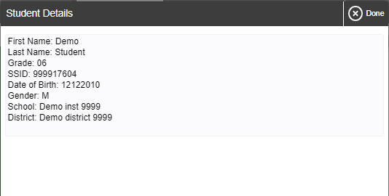
TA Interface - Student Lookup (continued)
Display student information
Notes:
If you see the student you are looking for, select the Eye button next to the student’s name. A new window displaying the student’s information will appear. Note that the information displayed may vary slightly from what is shown here.

Slide 35
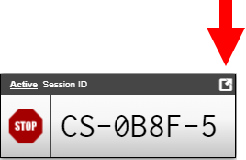
TA Interface - Screensaver Mode
CS-0B8F-5
Notes:
Since the student test progress tables in the TA Interface often contain sensitive student information, such as student IDs, the TA Interface contains a screensaver function to hide the data from view. If the screensaver mode is auto-enabled, the screensaver will automatically turn on if you are not active in the TA Site for five minutes. If the screensaver mode is not auto-enabled, it is strongly recommended that you manually turn on the screensaver mode when stepping away from your device.
To turn on screensaver mode, select the box icon in the top right corner of the session ID. The screensaver displays the Session ID and the timer, if applicable. It also displays notifications if students are awaiting approval, there are pending print requests, or if students require other interventions.
The screensaver will turn off automatically if any mouse or keyboard activity is detected. It will also turn off automatically if the test session times out due to TA or student inactivity or once the allotted time expires for a timed test.

Slide 36
Creating an Upcoming Proctoring or Assignment Test Session
Notes:
The process for creating an Upcoming Proctoring or Assignment Test Session is the exact same. Upcoming Proctoring Sessions are created on the Upcoming Proctoring tab. Assignments are created on the Assignments tab.
We will demonstrate an example in the following slides using an Upcoming Proctoring session.

Slide 37
Schedule an Upcoming Proctoring Session
Notes:
From your TDS Dashboard, select the “Upcoming Proctoring Sessions” tab. If you already have some Upcoming sessions scheduled for the future, they will display in the Upcoming Proctoring Sessions table.
To schedule a session, click the “Schedule an Upcoming Proctoring Session” button on the righthand side of your screen

Slide 38
Schedule an Upcoming Proctoring Session
Notes:
The “Upcoming Proctoring Session” Test Selection window will appear.
Select the start and end dates for your upcoming proctoring session.
This is the range of time you think you will administer the tests in the session.
This can be multiple days long, but you have to administer the entire session at one time. A single session cannot be administered across multiple days.
You can change these dates later, as long as the dates are in the FUTURE. If you schedule a session that begins today and ends tomorrow, this will now be considered an Active session, and cannot be modified again once created.
Once you have set the date, click “Next”.
The next step is to add tests to your session, identical to the steps on slides 19-24 when creating an Active Proctoring session. Please revisit slides 19-24 as needed.

Slide 39
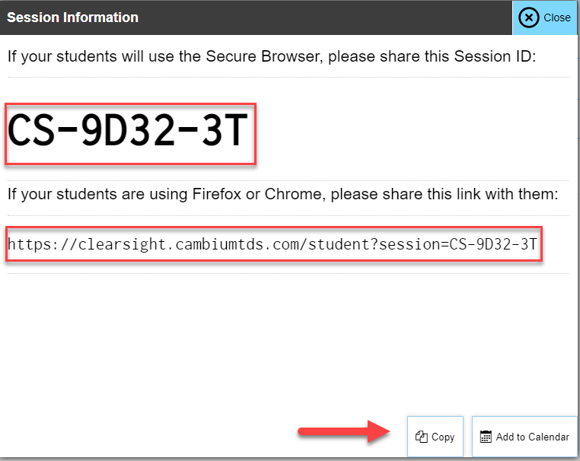
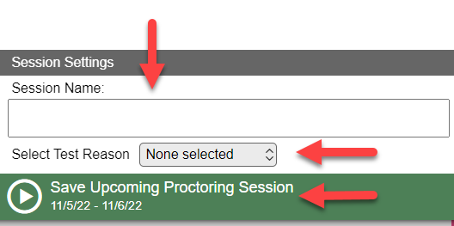
Schedule an Upcoming Proctoring Session
Notes:
Once you have made the test selections for the Upcoming session, input a Session Name on the bottom right side of the Test Selection Window as well as a Test Reason. Then select “Save Upcoming Proctoring Session”.
Once you have Saved your session, the Session Information pop-up will appear showing you the Session ID that students can manually enter into the Secure Browser application or if accessing the Student testing portal through the generic Student access URL.
You will also be presented with a unique session URL that includes your Session ID – this link can be readily shared with students so they can join the session during the designated testing window. This direct URL will include the Session ID pre-populated for students when logging in to join the test session.
You will also see buttons to Copy or Add to Calendar to save your session information for easy access later. Click “Close” to close the Session Information window and be taken back to your TDS Upcoming Proctoring sessions dashboard.
The Upcoming Sessions landing page will include useful information.
a. To share the session with students, select “Share Link”.
b. To edit before it begins, select “Edit”.
c. To delete it before it begins, select “Delete”.
d. Once the Start date occurs, this session will move to the “Active Sessions” tab.

Slide 40
Schedule an Upcoming Proctoring Session
Notes:
Back on your TDS Upcoming Proctoring sessions dashboard, you will now see your newly created session in your table of Upcoming Sessions.
You will see options to:
a. Share the session with students by selecting “Share Link”.
b. Edit the session dates, tests, or name PRIOR to the start date of the session by selecting “Edit”.
c. Delete the session before it begins by selecting “Delete”.
You will also see an “Export” button. This generates a downloadable file of all of your Upcoming Test Sessions.
a. Select “Export”, then retrieve the file from your download location.
b. The file displays the Session IDs, Name of Session, Start and End Dates.
Remember, once the Start date arrives, this session will now be considered Active and will be found under the “Active Sessions” tab. Once your Start date arrives, you can no longer edit this session.

Slide 41
Starting an Upcoming Proctoring Session
Once your scheduled start date has arrived, this session is now considered ACTIVE, and can be found on your Active Proctoring tab
Notes:
If order to start a test session that you previously scheduled in advance, the start date that you input when creating your session will need to have arrived. If your start date has not arrived, this is still considered an Upcoming Proctoring session and cannot yet be started.
If your start date HAS arrived, this test session will now be considered Active, and can be found on your Active Proctoring tab.
If your students are testing in the Secure Browser, share the Test Session ID with your students so they can manually enter the ID in the Secure Browser application.
If your students are testing in a public browser, click the “Share Link” button to copy and distribute the direct Test Session link with your students.
Once your students have your Test Session information, click “Join” to be taken to the TA Interface as referenced on slides 25-35.
NOTE: when following this same process to create an un-proctored Assignment session, Proctors will NOT have the option to “Join” an Assignment test session, as these are asynchronous test sessions that do not involve a live proctor. You simply use the “Share Link” button to share your direct Test Session link with students, or provide them with the Test Session ID to manually enter themselves, just like you would for any other test session.

Slide 42
Student Login via Secure Browser or Public Browser Links
Notes:
We have addressed Student access throughout the previous slides, but we will highlight steps for student access within the Secure Browser and via Public Browser in the following slides.

Slide 43
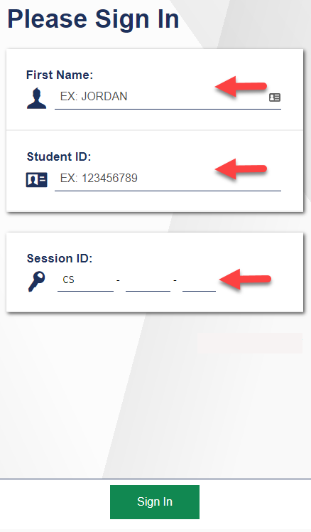
Student Login via Secure Browser
Notes:
For a student to log in to a test session on the Secure Browser, s/he will open the Secure Browser testing application from the desktop or homepage of their device.
The student will need to enter her/ his first name, their Student ID, and the Test Session ID that was created by their Proctor for their specific testing session.

Slide 44
Student Login via Generic Public Browser Link
Generic Student Login Link:
https://clearsight.cambiumtds.com/student
Notes:
For a student to log in to a test session on a standard internet browser using the generic Student login link, s/he will open an internet browser on their testing device and enter the generic Student login link (https://clearsight.cambiumtds.com/student) .
The student will need to enter her/ his first name, their Student ID, and the Test Session ID that was created by their Proctor for their specific testing session.
Along with the session id that was created when you configured the test session.

Slide 45
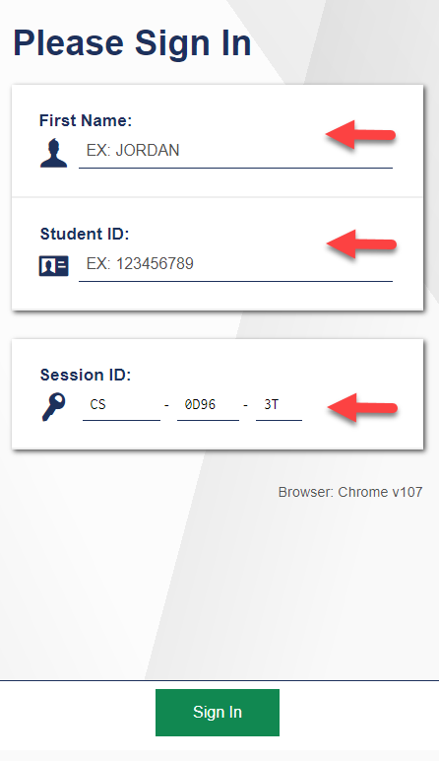
Student Login via Direct Public Browser Link
Direct Student Login Link Example:
https://clearsight.cambiumtds.com/student?session=CS-0D96-3T
Link includes the Test Session ID
Notes:
For a student to log in to a test session on a standard internet browser using the Direct Student login link, s/he will open an internet browser on their testing device and enter the direct Student login link as provided by their Proctor.
The student will only need to enter her/ his first name and their Student ID, as the Test Session ID has been pre-populated for them through the use of the Direct Student Login Link.

Slide 46
Monitoring a Test Session
Notes:
Once students log in and are approved for testing, you can monitor their status from the table(s) displayed on the TA Interface.

Slide 47
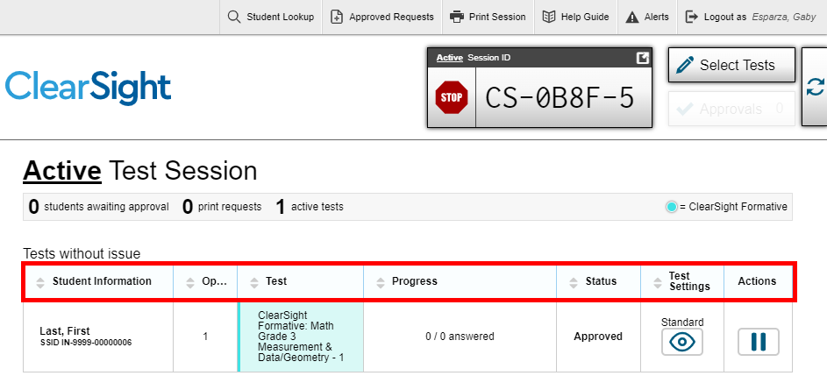
Monitoring Student Progress
Notes:
Once students log in and are approved for testing, you can monitor their status from the table(s) displayed on the TA Interface. The table shows Student Information, Opportunity Number, Test Name, Progress, Test Status, Test Settings, and an Actions option.
The Progress column displays the student’s progress through the items in the test. It may display a progress bar to indicate the student’s progress through the test or display the total number of items completed thus far and the total number of items in the test.
The Test Status column indicates a student’s testing status. For a list of test statuses, please see the Test Administrator User Guide.
The Test Settings column displays either Standard or Custom. This column displays Custom when a student’s test settings are different from the default settings for that test. Select the Eye button to view a student’s test settings. In some states, the number of accommodations and designated supports will also appear.
The Actions column allows you to pause a student’s test. If a student requests a printout, a printer icon will appear in this column.

Slide 48
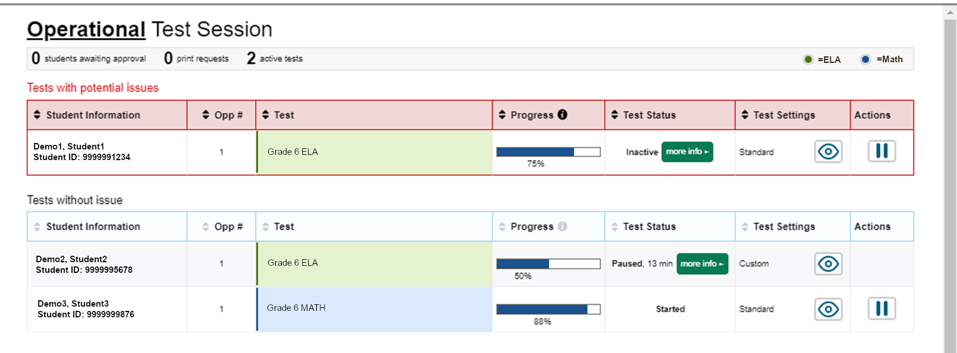
Test with Potential Issues Table
Notes:
If the Test Delivery System (TDS) detects that a student may be having technical issues or requires assistance, a “Tests with potential issues” table will appear above the “Tests without issue” table. A “more info” icon will appear in the Test Status column. Hovering over this icon will display more information about the issue.

Slide 49
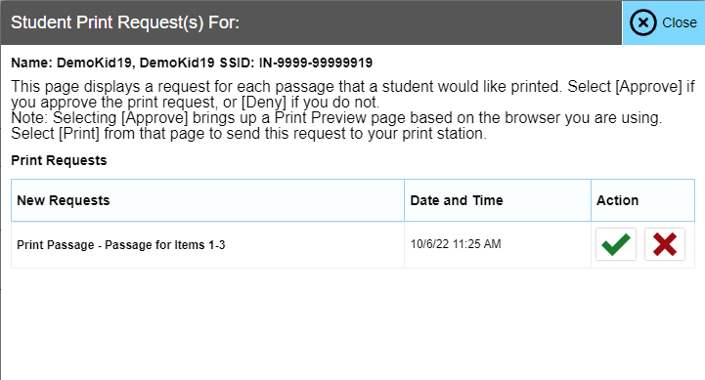
Print on Request
View print request
approve
deny
Notes:
The Print on Request feature is available only for students who require it. Please contact your School Test Coordinator if your student needs this accommodation. It is a testing impropriety to apply this restricted resource for a student who does not have an IEP or Section 504 Plan documenting his or her need for the accommodation.
Students with this accommodation can request printouts of stimuli and/or items, depending on their settings.
• When a student sends a print request, the Printer button will appear in the Actions column of the Tests with potential issues table on the TA Interface. Select the button to view the request.
• If you select the Check button to approve the print request, a cover sheet containing the student’s name and SSID will display in a new browser window. No test content will ever display on your screen.
• Select Print in the new window to complete the print request. The printer dialog box will display.
• Select OK to send the request to the printer.
• If you select the X button to deny the print request, nothing will be printed.
Before approving the student’s print request, ensure that it will be sent to a printer that is monitored by staff who have been trained in test security. All printed test items, stimuli, and reading passages must be securely stored and destroyed immediately following a test session.

Slide 50
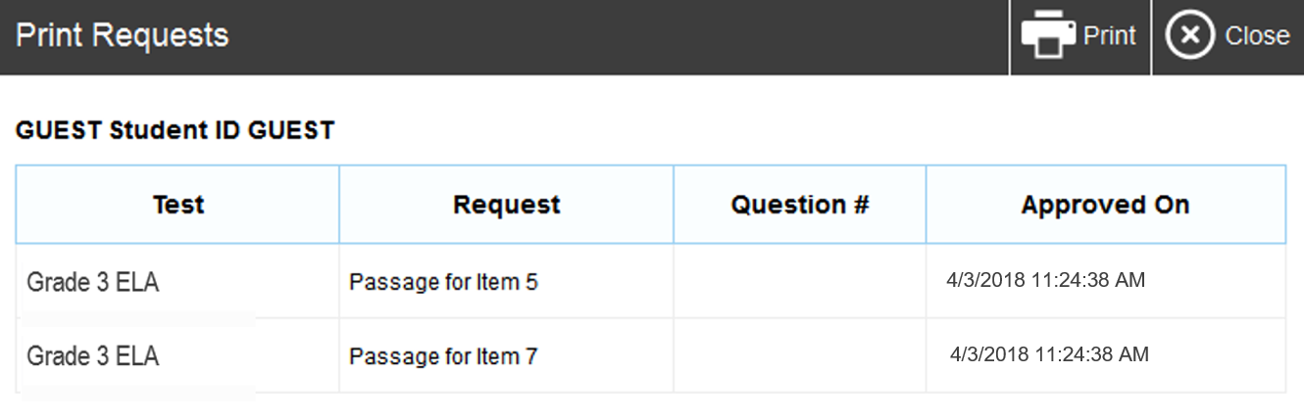
Approved Requests
Notes:
The Approved Requests button allows you to view a list of every print request you approved during the current session. If you wish to print this list for your own records, select Print at the top of the Print Requests window.

Slide 51
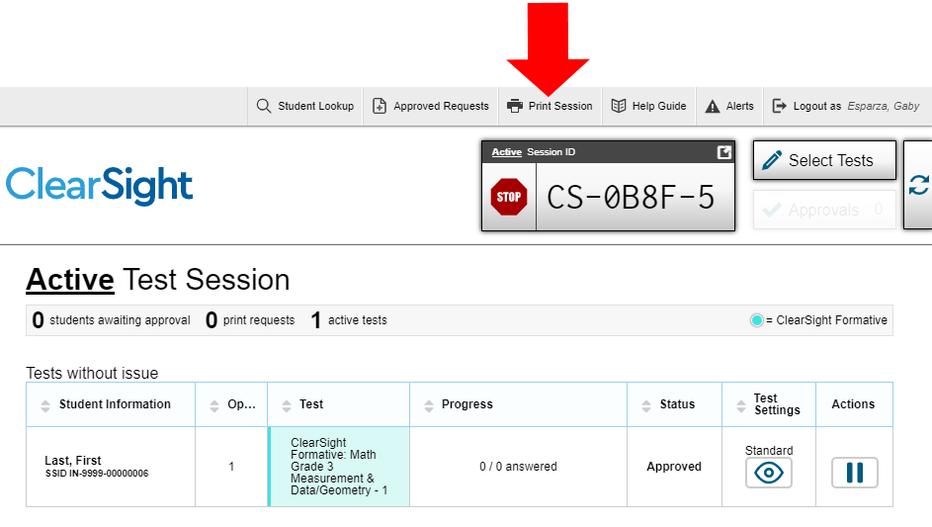
Printing Test Session Information
Notes:
If you wish to print a snapshot of the TA Interface in its current view, select the Print Session button. This can be useful for tracking which students did not complete their tests and may need to be scheduled for another session. It may be necessary to set the page layout to landscape or adjust the margins in the Print Preview screen in order for the list to fit on the page. Remember that any printouts containing personally identifiable student information must be securely stored and should be destroyed after use.

Slide 52
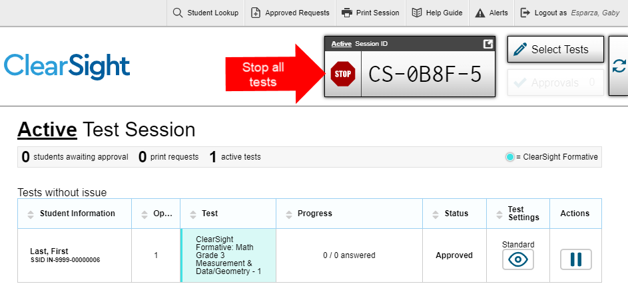
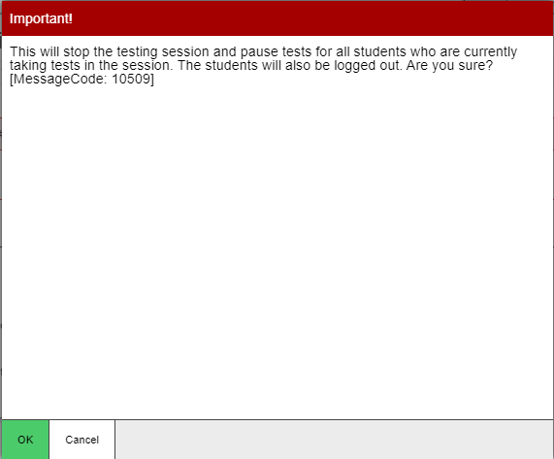
Pausing and Stopping Sessions
Notes:
You have two options within the TA Interface to pause or stop testing once it has begun. You can pause an individual student’s test or stop the entire session. To pause an individual student’s test, select the Pause button in the Actions column on the “Tests with potential issues” or “Tests without issue” table for that student. When prompted, select OK to confirm that you want to pause the test. This option would be appropriate if a student becomes ill, for example. In the event of an emergency that requires all students to stop testing, you can pause all students’ tests by stopping the session.
If you stop the session, all in-progress tests will be paused. If a session stops, it cannot be resumed. You will have to create a new test session and give the new session ID to students so that they can resume testing. To stop the entire test session for all students, do the following:
• Select the Stop button next to the session ID. A pop-up message will appear requesting verification to end the session and log students out.
• When prompted, select OK to continue.
If you forget to log out before leaving the testing area, the session will close automatically after 20 minutes of inactivity on both the TA and student computers. You would then need to create a new session and provide the new session ID to students in order to resume testing.

Slide 53
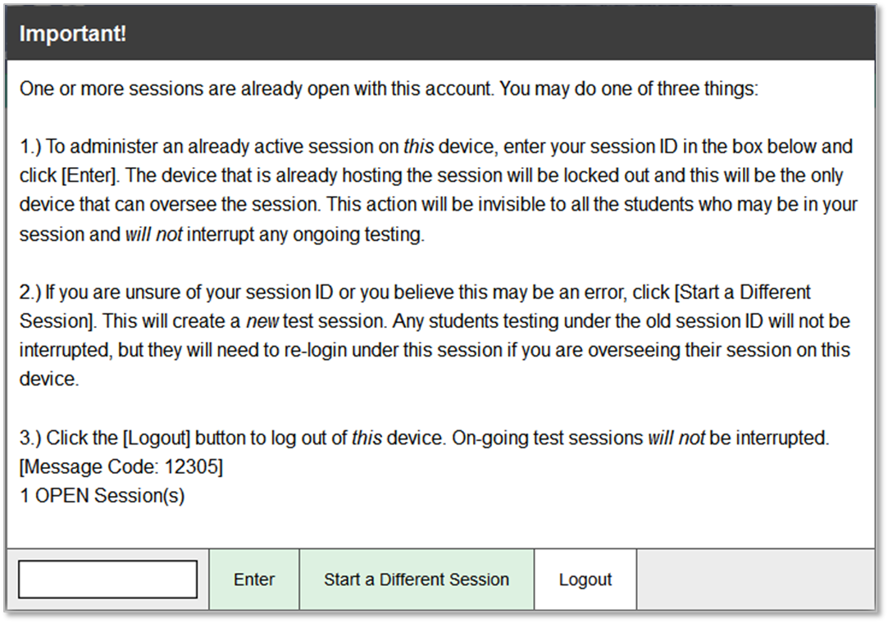
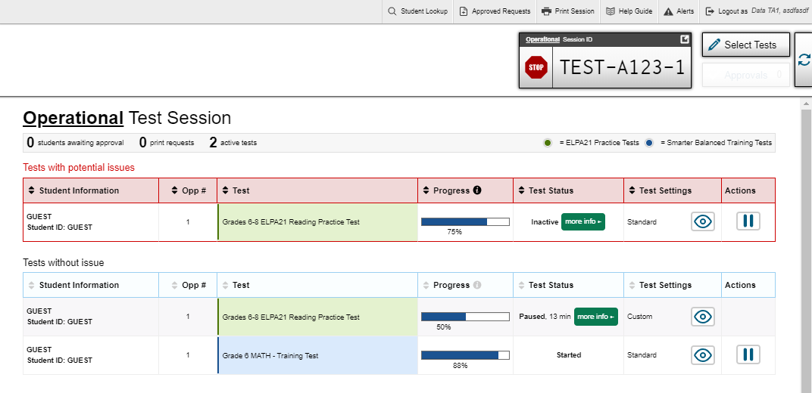
Transferring Sessions
Session ID
Notes:
In the event that you have problems with your computer or web browser or need to change computers during an active test session, you can transfer the session from one computer, mobile device, or browser to another without stopping the session or interrupting in-progress tests. To transfer a test session to a new device or browser, remember the following:
• Do not log out of the session you are currently in or stop the test session. If you do, you will end the test session and pause all students’ tests.
• Log in to the TA Interface on the new machine or in the new browser. A session ID prompt will appear.
• Enter the active session ID in the text box and select Enter. When the session ID is validated, you will be able to continue your test administration activities.
The test session on the previous computer or browser will close automatically. This will not stop the session or pause student tests.

Slide 54
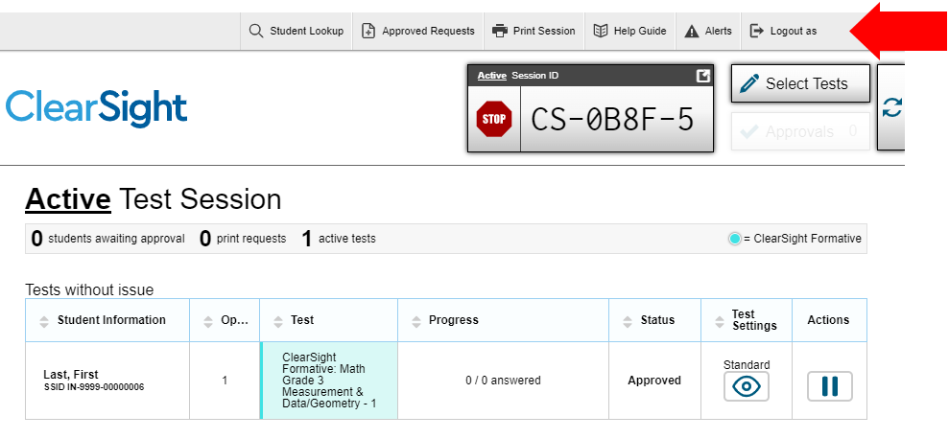
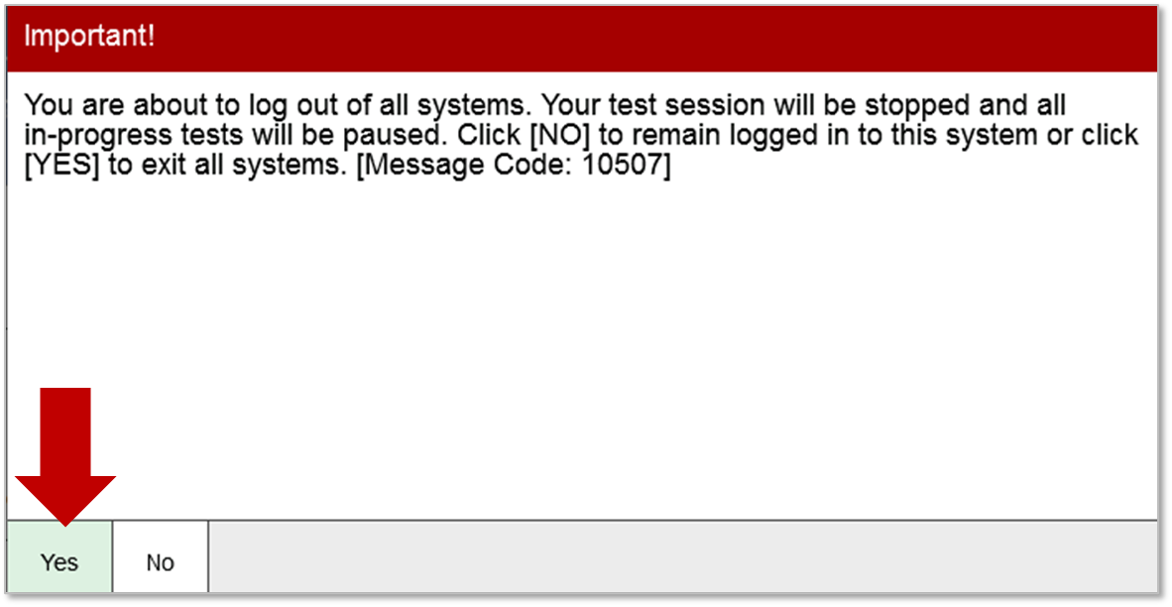
Logging Out of the TA Interface
Notes:
To log out of the TA Interface, select the Logout button in the upper-right corner of the page. It is preferable for you to log out only after stopping your active test session, as logging out will cause all in-progress tests to be paused. A confirmation message will appear, asking you to confirm that you want to exit the website and pause all students’ in-progress tests. This scenario also occurs when you navigate to another website from the TA Interface.
However, regardless of when or how you log out or navigate away from the TA Interface, student data will NOT be lost. If you need to access another application, we encourage you to open it in a separate browser window.

Slide 55
Troubleshooting
Description | What to Do
What should I do if a test session ends? | Log in and start a new session. Provide the students with a new session ID.
What should I do if a student gets logged out of a test while a session is still active? | If a student’s test session is interrupted, the student should log back in and rejoin the session.
What should I do if forbidden applications are running? | The Secure Browser will not allow the student to begin testing if forbidden applications are running. You will see messages advising you which applications must be closed before testing can begin.
What should I do if a student’s test freezes? | Force-quit the Secure Browser and log back in. For instructions, refer to the Test Administration Manual.
Notes:
This table presents some of the common issues that you or your students may encounter during a test session. Please take a moment to review this information. For more detailed information please refer to your Test Administration User Guide.

Slide 56
Thank You!
For more information, please visit:
ClearSight Portal
ClearSight Help Desk
Notes:
Thank you for viewing this training module. If you have general questions or need further information, please visit our ClearSight portal or consult the Help Desk for assistance.

