Slide 1
ClearSight Training:
Reporting
2023-2024

Slide 2
Support Resources
ClearSight Portal
Training slides
User manuals
Quick guides for common actions
and much more!
ClearSight Help Desk (via “Contact Us” page)

Slide 3
Reporting Topics
The Basics
More Advanced
Log in to Reporting & Understand User Roles
Dashboard Generator Page & the Dashboard
Performance on Tests Report
District, School, Teacher, and Student Reports
Print and Export Data
Generate Individual Student Reports (ISRs) & Student Data Files
Use the Longitudinal Report and the Demographic Breakdown Report
Tests with Reporting Categories
View and Interpret Writing Dimension Measures
Work with Interim Reports—Their Items, Rubrics, and Scoring Essentials
Change Reporting Time Period
Manage Test Reasons
Create a Roster
Notes:
This module consists of two parts. The first part, The Basics, slides 3–41, covers general tasks like logging in and navigating from the dashboard generator through the subsequent reports for district and school users and teachers. Topics then include printing and exporting data and generating ISRs and student data files. The section finishes with two unique reports, the Longitudinal Report and the Demographic Breakdown Report.
In the More Advanced section, slides 42–72, results featuring reporting categories, standard measures, Depth of Knowledge levels, and Writing Dimensions are covered first, followed by a section on working with interim tests, specifically their items, rubrics, and scoring essentials. The section concludes with three actions under the Features & Tools menu: changing the reporting time period, managing test reasons, and creating a roster.

Slide 4
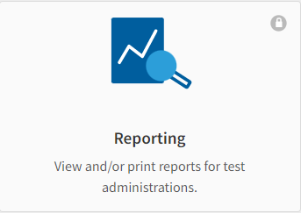
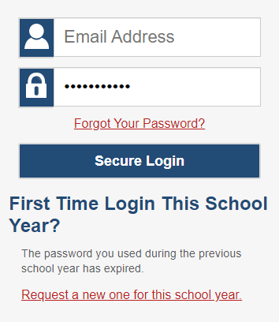
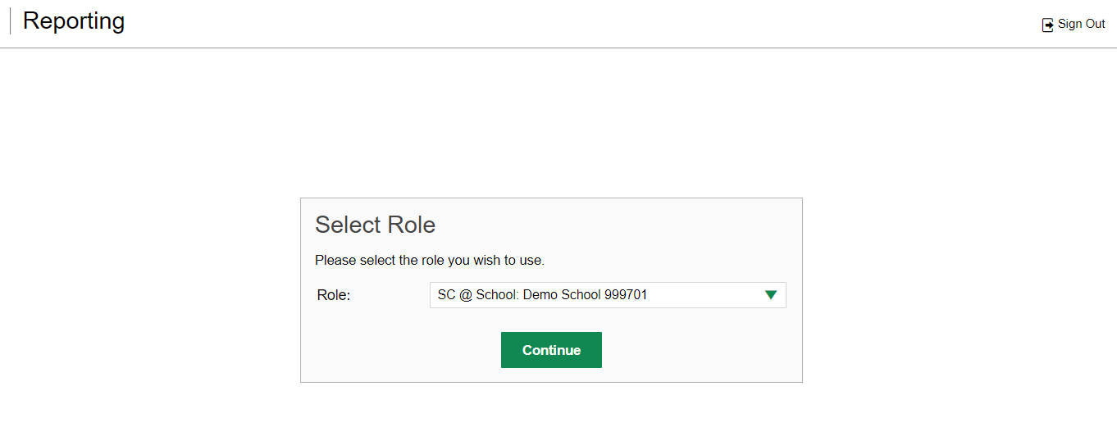
Log In to Reporting
Notes:
1. To log in to Reporting, go to your portal.
2. Select the Educators and Test Administrators: Access ClearSight Systems on the home page or click Actions from the top navigation.
3. Click the Reporting card.
4. Enter the email address associated with your Test Information Distribution Engine (TIDE) account and your password.
5. Then select Secure Login. If you are assigned multiple roles, you are prompted to select a role from the drop-down menu.
6. Click Continue to display the Dashboard Generator.

Slide 5
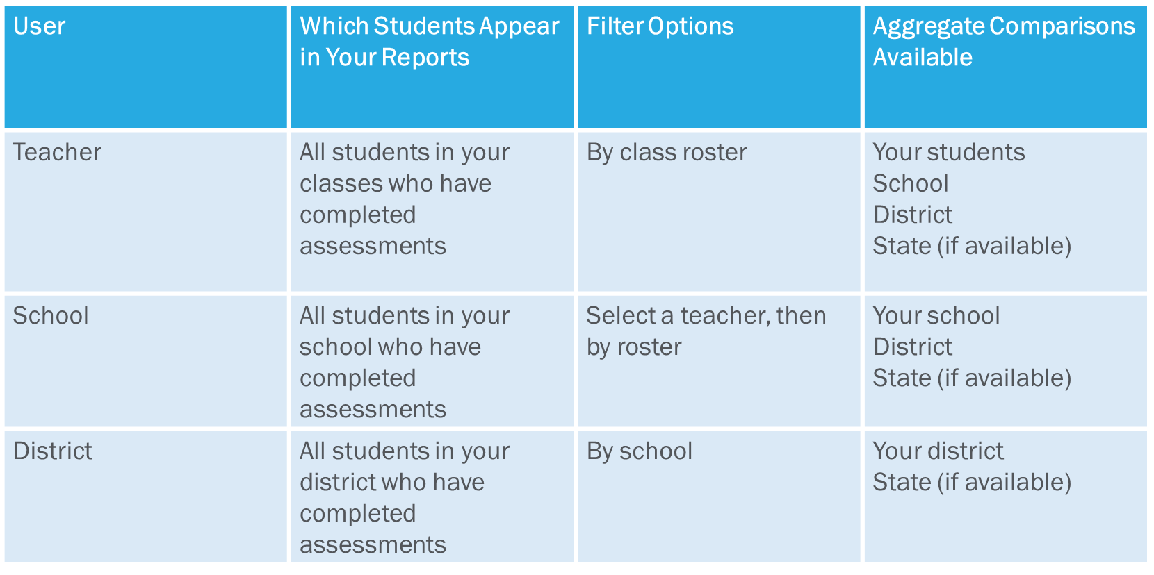
Understand Different User Roles
Notes:
Teachers, school-level users, and district-level users have access to different features and data in the Reporting System. This chart summarizes which students will appear in your reports, the filter options, and the aggregate comparisons available for each of the three roles.

Slide 6
User/Data Access to Reporting
ClearSight Users
Reporting data is based on your user role in ClearSight:
District Users can see all data in the district.
School Users can see all data in the school.
Teacher Users can see all data for:
Students rostered to them;
Students to whom they administer tests.
District Data Security Officer
DDSO
District Coordinator
DC
District Data Viewer
DDV
School Data Security Officer
SDSO
School Coordinator
SC
Teacher
TE
Proctor
PR

Slide 7
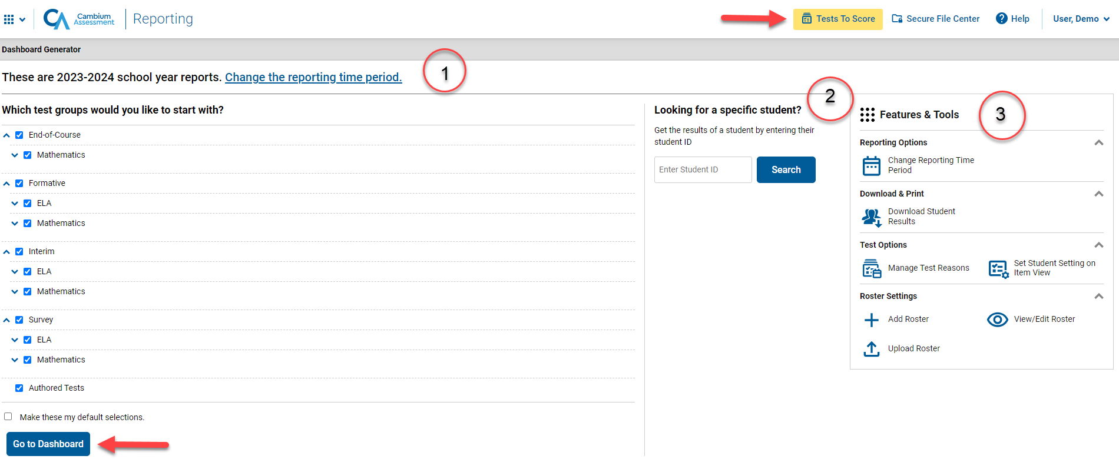
Dashboard Generator
Notes:
The Dashboard Generator page displays. This page is queued to display BEFORE the appearance of the dashboard so you can easily customize your results in order to view only the data that are most helpful to you.
The banner displays your username and your role. The banner also displays the Secure File Center, a Help button, and a Sign Out button.
There are three prominent sections on the page. In section 1, you will find the test group selection section where you can check only the tests that apply to your needs and make those your default selections. In section 2, you can access an individual Student Portfolio report by entering a student ID number in the search box. In section 3, you see the Features & Tools menu where you can take some actions prior to viewing data on the dashboard.
To save your selections, mark the checkbox Make these my default selections. These selections will be set in the Dashboard Generator whenever you log in. You can change the defaults at any time.
Click Go to Dashboard.

Slide 8
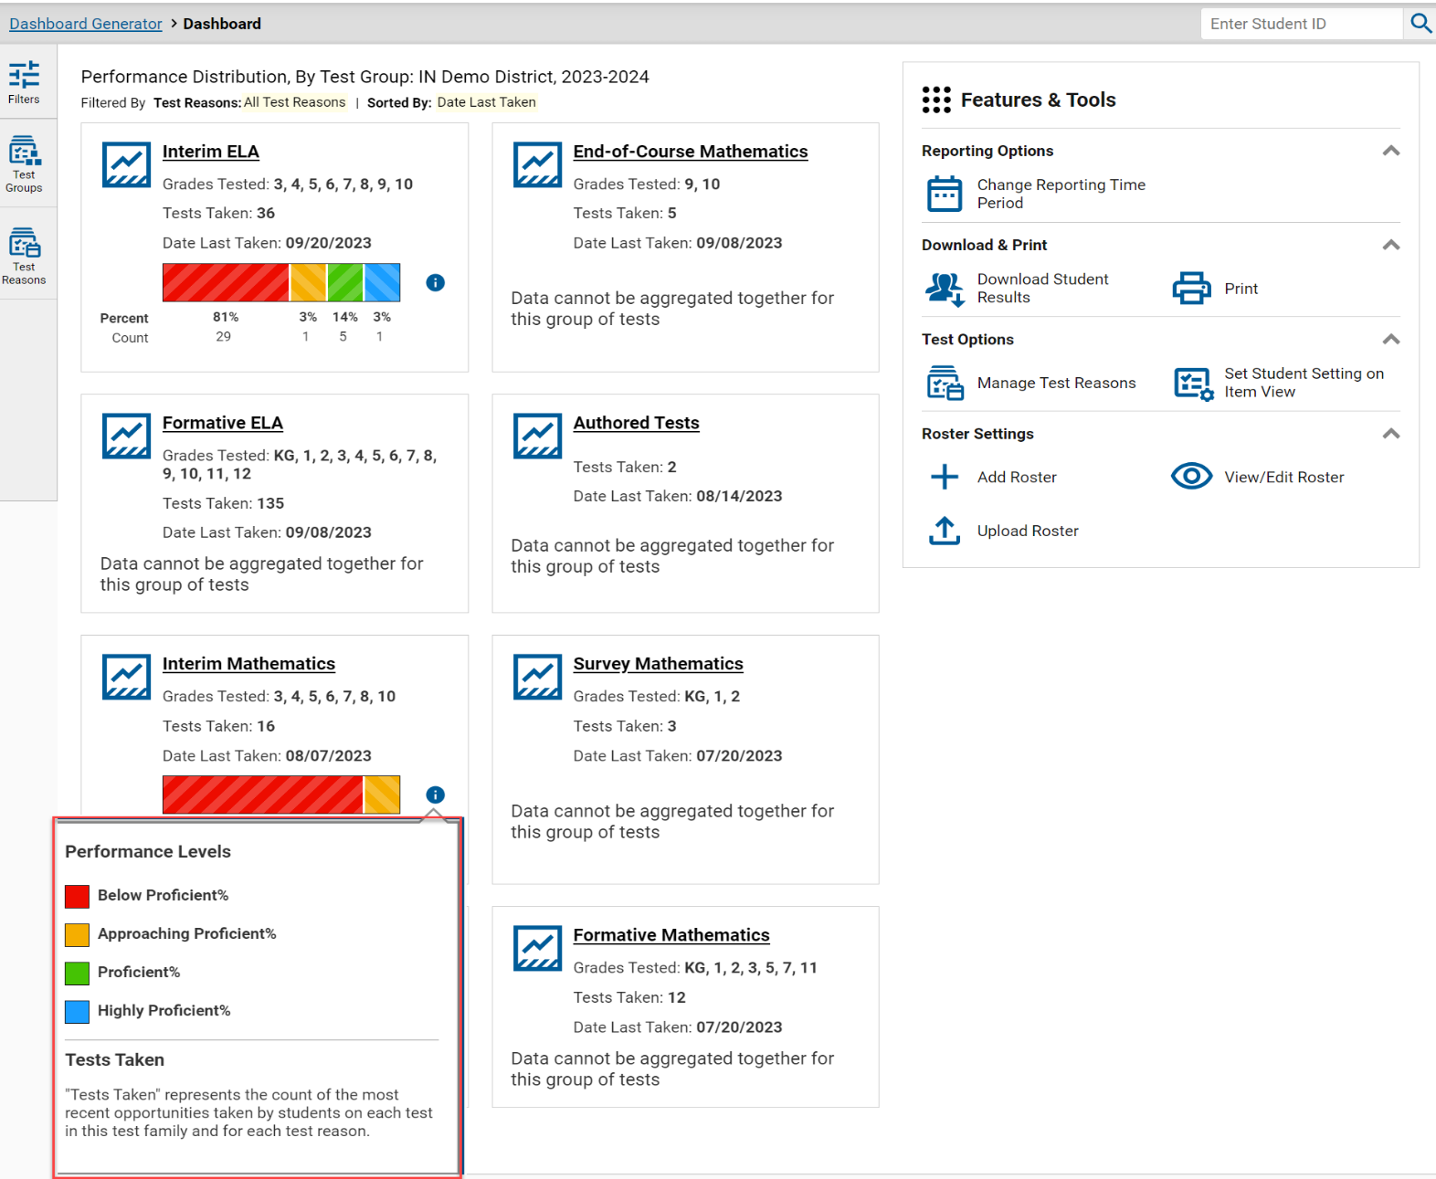
Dashboard—Test Group Cards
Notes:
The Dashboard appears after you select test groups. Test information and results are displayed for the students who are assigned to you based on your role. Teachers see all the tests their students have taken. School-level users see tests taken by all the students in the school. District-level users see the tests taken by all the students in the district.
A test group card displays for each test, by subject, along with the grades tested and the total tests taken. The cards are sorted from left to right, then top to bottom based on the date last taken. The performance distribution results display as a color-coded bar with the percent proficient and student count listed under each colored level. Click the green information button to display the performance levels. For example, 36 students took the English Language Arts test. 81% of them at the Does Not Meet Standard level (Below Proficient), 3% of them at Partially Meets Standard(Approaching Proficient), 14% of them at Meets Standard (Proficient), and 3% of them performed at Exceeds Standard (Highly Proficient). The data on the dashboard gives teachers, administrators, and principals a way to quickly compare how their students performed across different test groups.

Slide 9
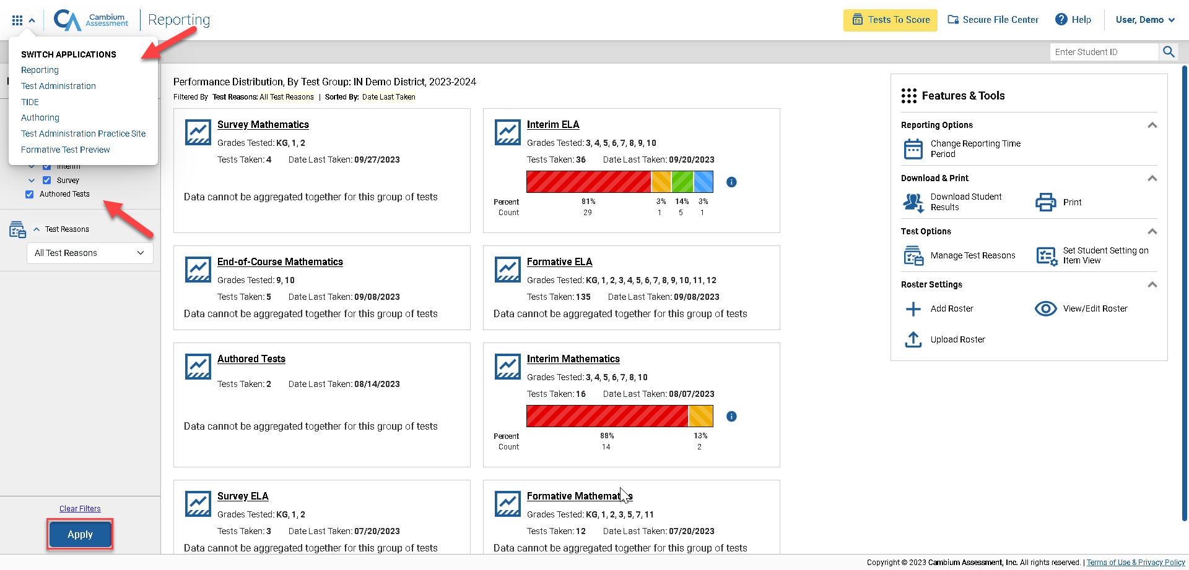
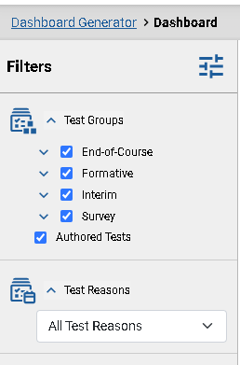
Dashboard—Filters Panel
Notes:
If you want to change the data you see, use the Filters panel to further customize your Dashboard. Make selections from the Test Groups options and/or the Test Reasons options. Test Reasons typically represent test administration seasons or opportunities. Selecting a test reason filters out results you do not need to see.
Click the blue Apply button and your dashboard customizes according to your selections. Filter selections are highlighted in yellow in the table of results header. Clear the filters at any time by clicking the Clear Filters button and clicking Apply again..
In the upper-left corner of each page in Reporting is the “System Switcher.” You can move from the Reporting system directly into the TA Interface, The Reporting Innterface the Data Entry Interface, TIDE, and other systems when you need to perform tasks in those systems. You don’t have to log out and log back in.
Click on the underlined name of a test group card or the green magnifying glass view button to advance to the Performance on Tests report.

Slide 10
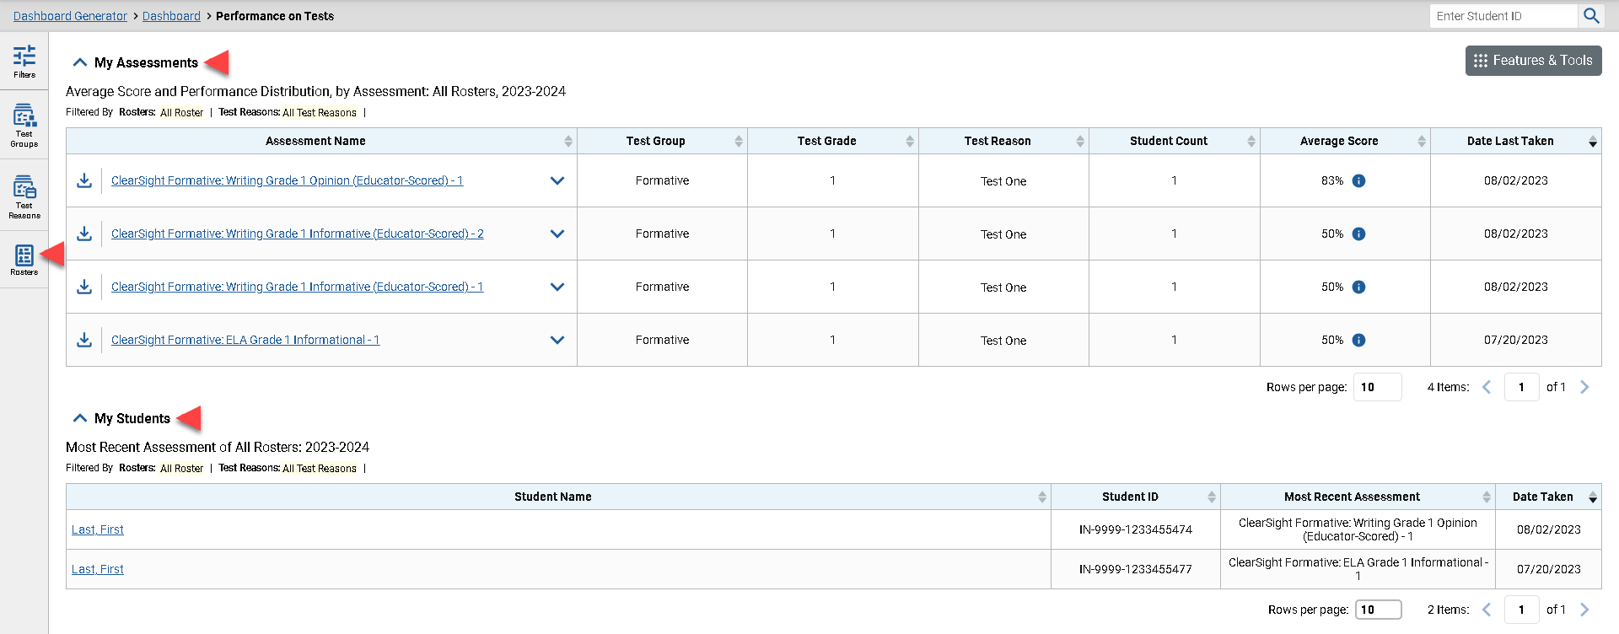
Performance on Tests Report for a Teacher—Two Tables
Notes:
When they select a test group card and leave the Dashboard, all users move to the Performance on Tests report. The My Assessments table lists all the tests that the teacher’s students have taken, in order of date last taken.
The My Students table is a fast pass to the individual Student Portfolio report. This report is useful for teachers as they prepare for parent-teacher conferences where student performance across all tests is needed.
Teachers also have a Rosters option in the Filters panel. They can select one of their rosters, click Apply, and the Performance on Tests report customizes to show results for only students on the selected roster.

Slide 11
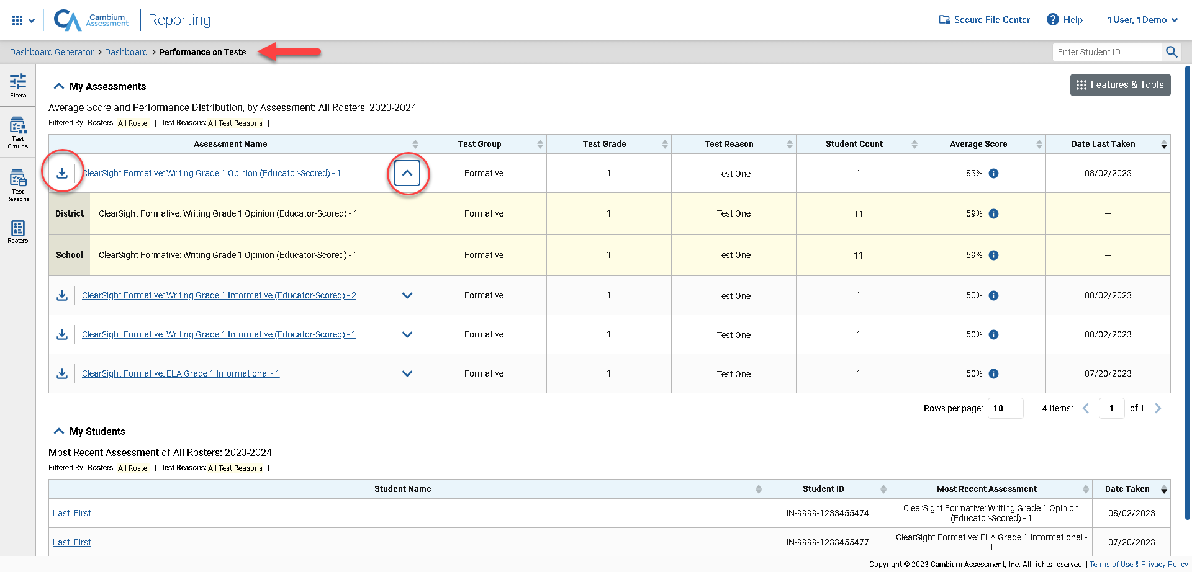
Performance on Tests Report for a Teacher—Aggregate Comparison Rows
Notes:
You can compare your results to aggregate state, district, and school data directly from the Performance on Tests report, depending on your user role. Simply click the expansion arrow to the right of the assessment name to display them. Shown here are the comparison rows a teacher will see. The aggregates are highlighted in yellow below the Assessment Name. Notice that an export button is included for each test in the table. Use it to generate a PDF, Excel, or CSV file of the results for that test.
Notice the path in the navigation trail at the top of the report page. Since this teacher has a single role, the Select Role breadcrumb does not display. The teacher has navigated from the Dashboard Generator to the Dashboard to the Performance on Tests report. You can use this trail to return to any previous page in Reporting.
Click on the underlined name of the report to drill down further into test data.

Slide 12
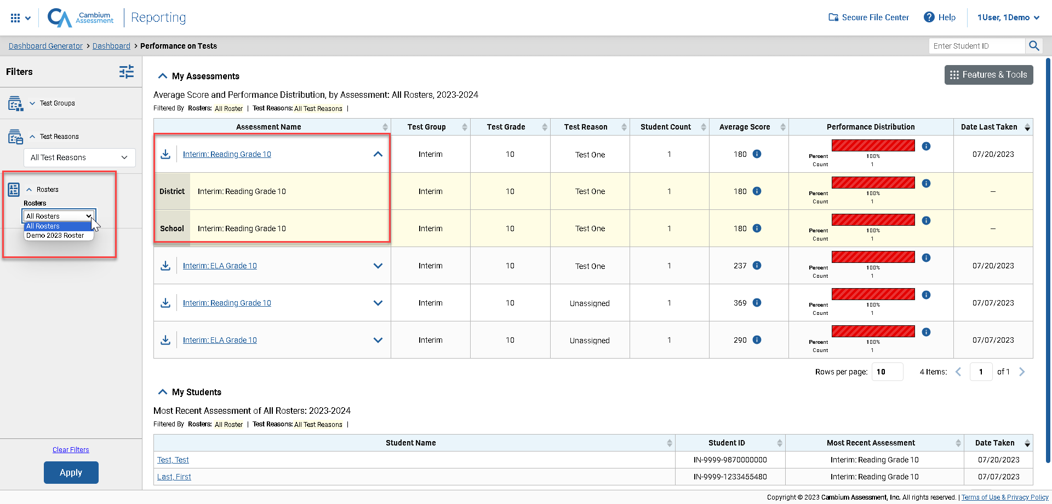
Performance on Tests Report for a School-Level User
Notes:
Here is the Performance on Tests report for a school-level user who selected the ELA test group card from the Dashboard. It lists all the ELA tests the students in the school have taken. Notice there is a Rosters option included in the Filters panel. Principals and other school-level users can select a teacher then select one of their rosters to narrow down the results in the report. The school user will see District and School aggregates in the yellow comparison rows.

Slide 13
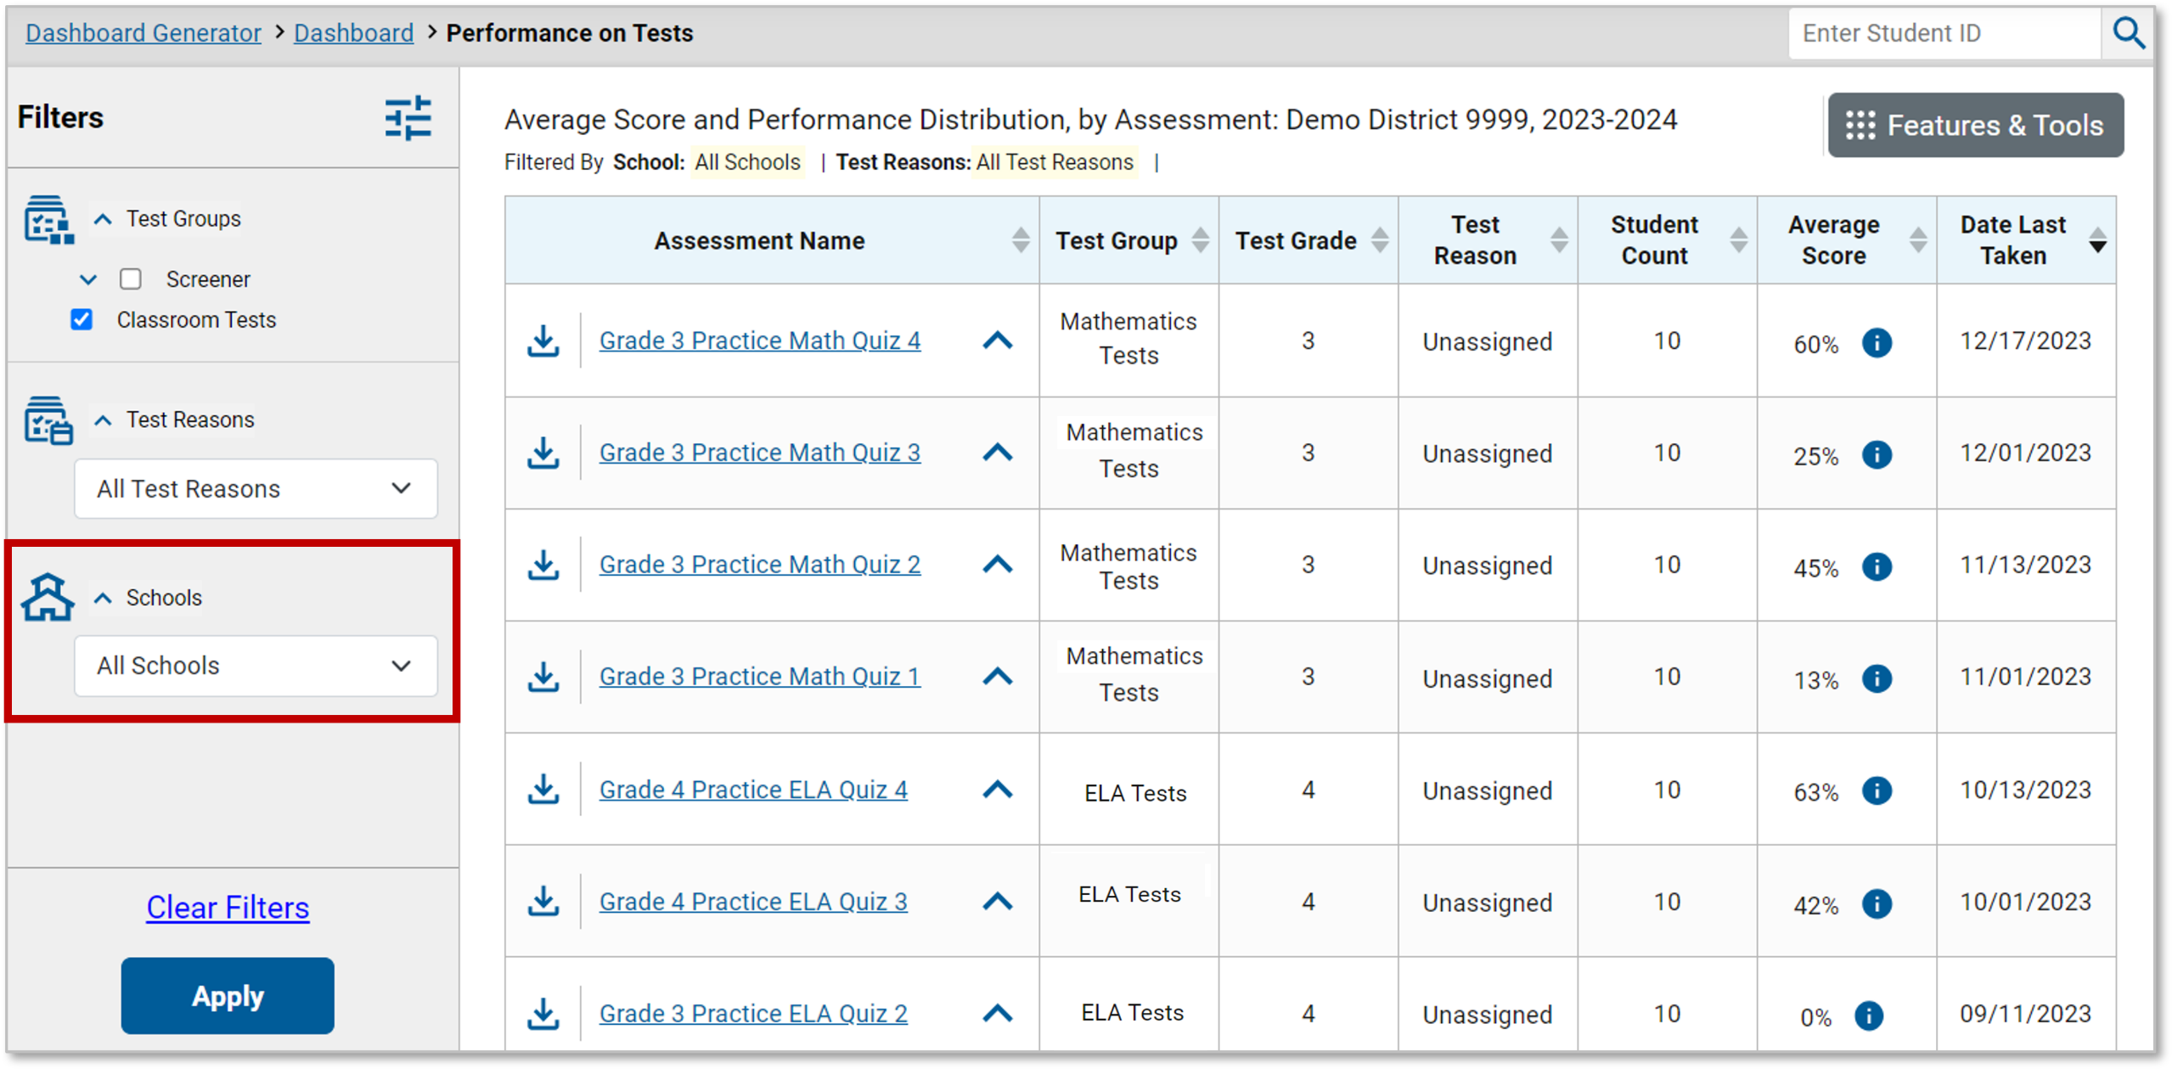
Performance on Tests Report for a District User
Notes:
Here is a Performance on Tests report as it displays for a district-level user who clicked on the Mathematics test group card on the Dashboard. The Filters panel now includes a Schools dropdown menu so that users can filter for one specific school. Select an Assessment Name from that column to see the District Performance on Tests report for that test.

Slide 14
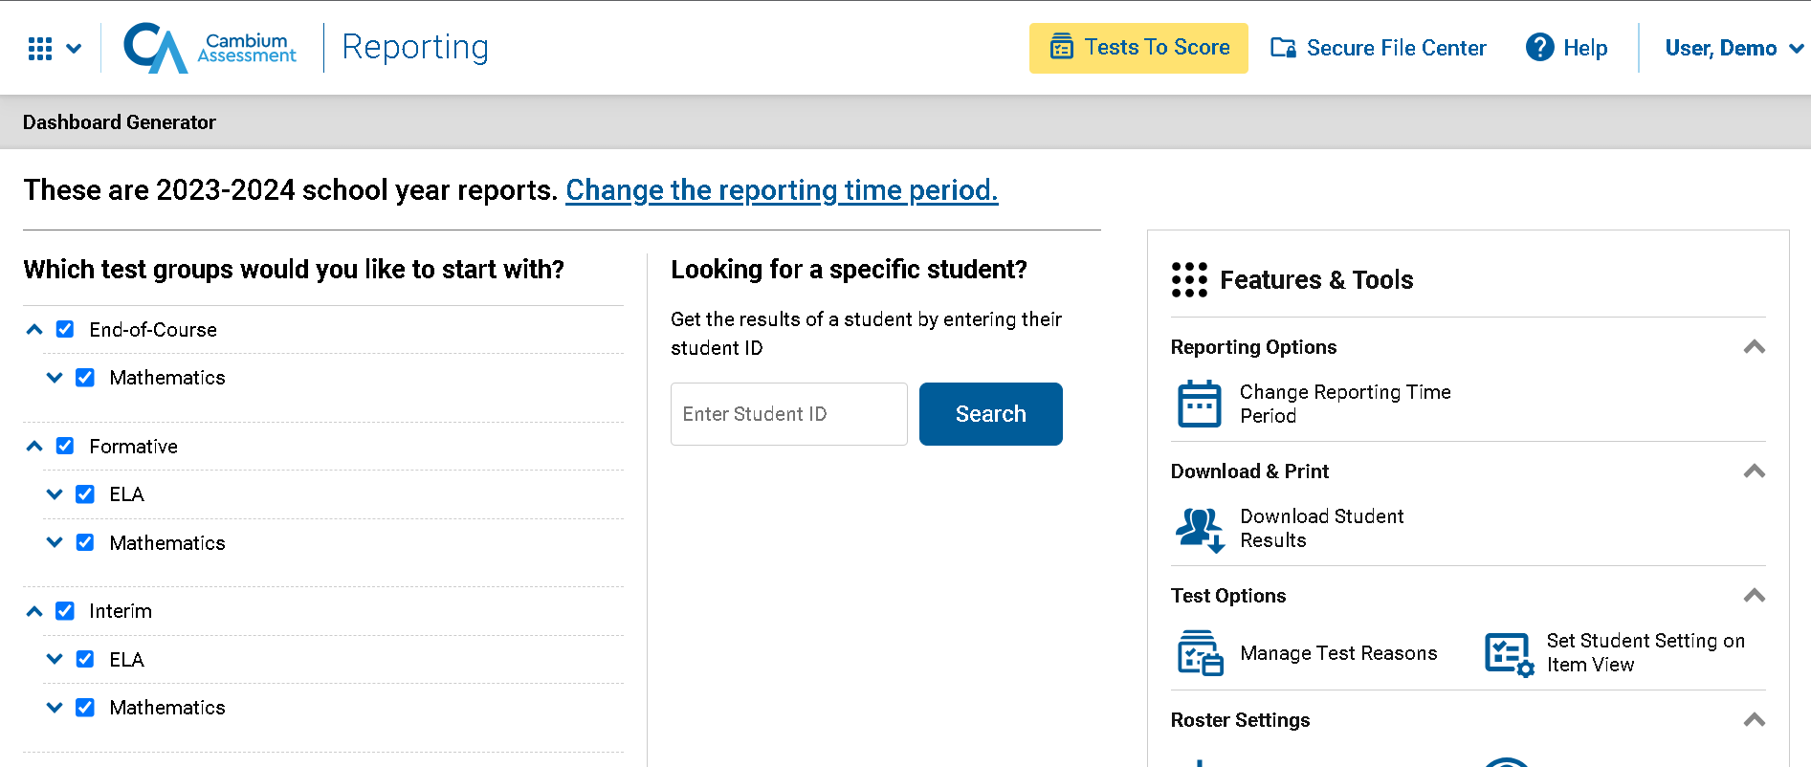
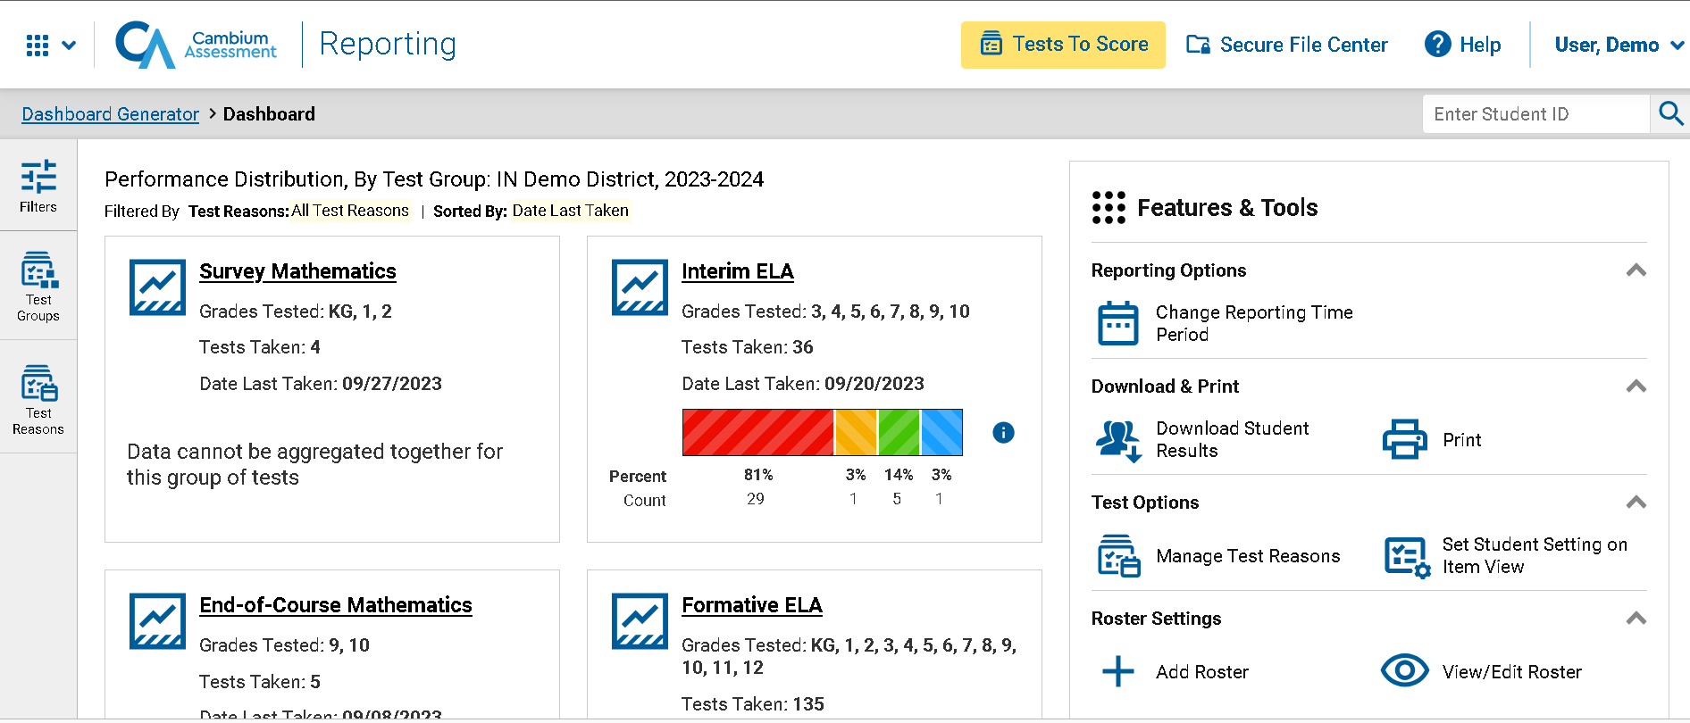
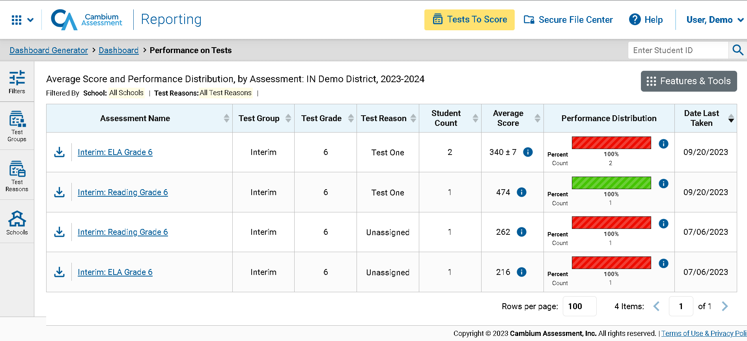
Recap: Reporting Navigation
1
2
3
Notes:
To review the sequence of navigation: Reporting opens with the Dashboard Generator, followed by the customized Dashboard, then the Performance on Tests report. From there, you drill down into more specific test data. District users navigate to district reports, school-level users navigate to school reports, and teachers navigate to “My Students’” reports.

Slide 15
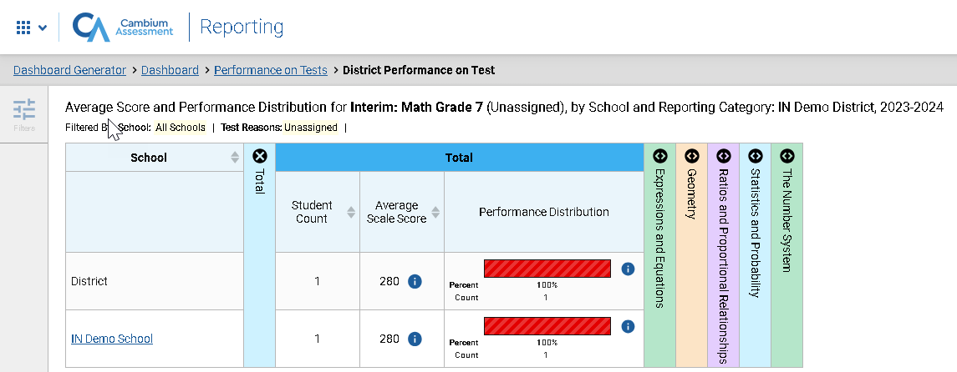
District Performance on Tests Report
Notes:
When district-level users select a test from the Performance on Tests report, the District Performance on Test report opens with a display of the schools in the district and the aggregate data for each school for the test group you selected. The District comparison rows now display at the top of the results table, along with Student Count, Average Scale Score, and the Performance Distribution indicator.
The columns you'll see will vary depending upon the type of assessment you've selected. Interims are reported in scale scores and proficiency levels, whereas all ClearSight Formative and K-2 Survey tests are reported in raw scores and percent correct.
This view also includes expandable reporting categories that correspond to the assessment type you're exploring.
To navigate to school-level results, click the name of a school.

Slide 16
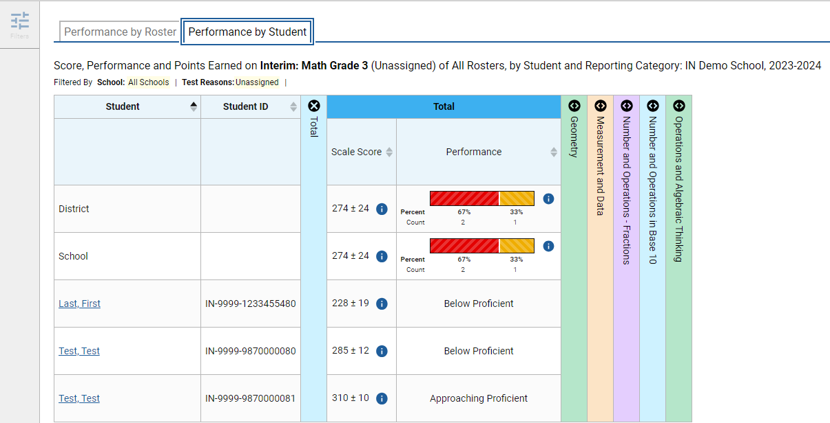
School Performance on Test Report—Roster Tab
Notes:
In the School Performance on Test report, results are organized by Roster, by default. Two tabs, Performance by Roster and Performance by Student, appear at the top of the results table, allowing the school-level user to toggle between roster results or student results.
You may be able to check the Test Completion Rate for each roster in the school using this report, as well as Average Scale Score, Performance Distribution, and any other performance measures in use.

Slide 17
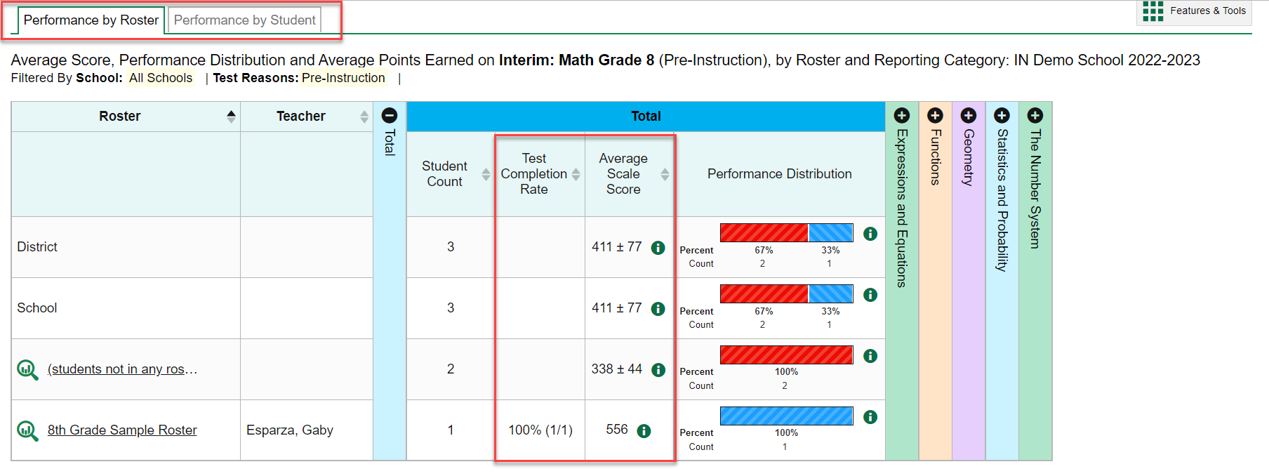
School Performance on Test Report—Student Tab
Notes:
Here is the same School Performance on Test report showing Performance by Student. There is one more drill down option at this point -- to isolate a student’s test results by clicking on the Student name or the magnifying glass view button to the left of it.

Slide 18
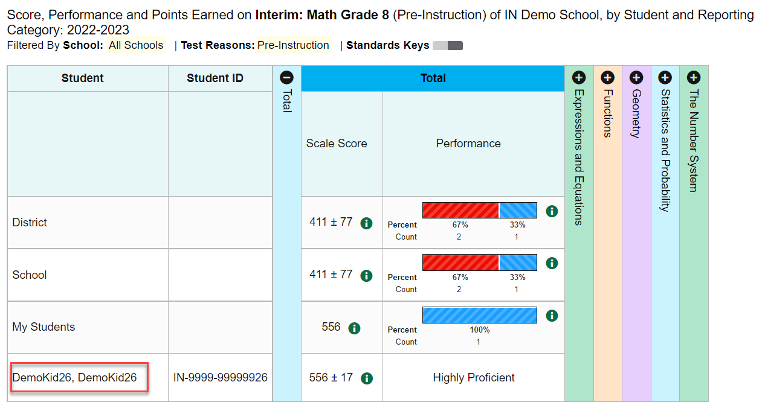
Student Performance on Test
Notes:
Here is the Student Performance on Test report showing a single student’s performance. Note that the student’s name is no longer underlined, nor is there a green magnifying glass view button next to it. This is the end of the navigation trail.

Slide 19
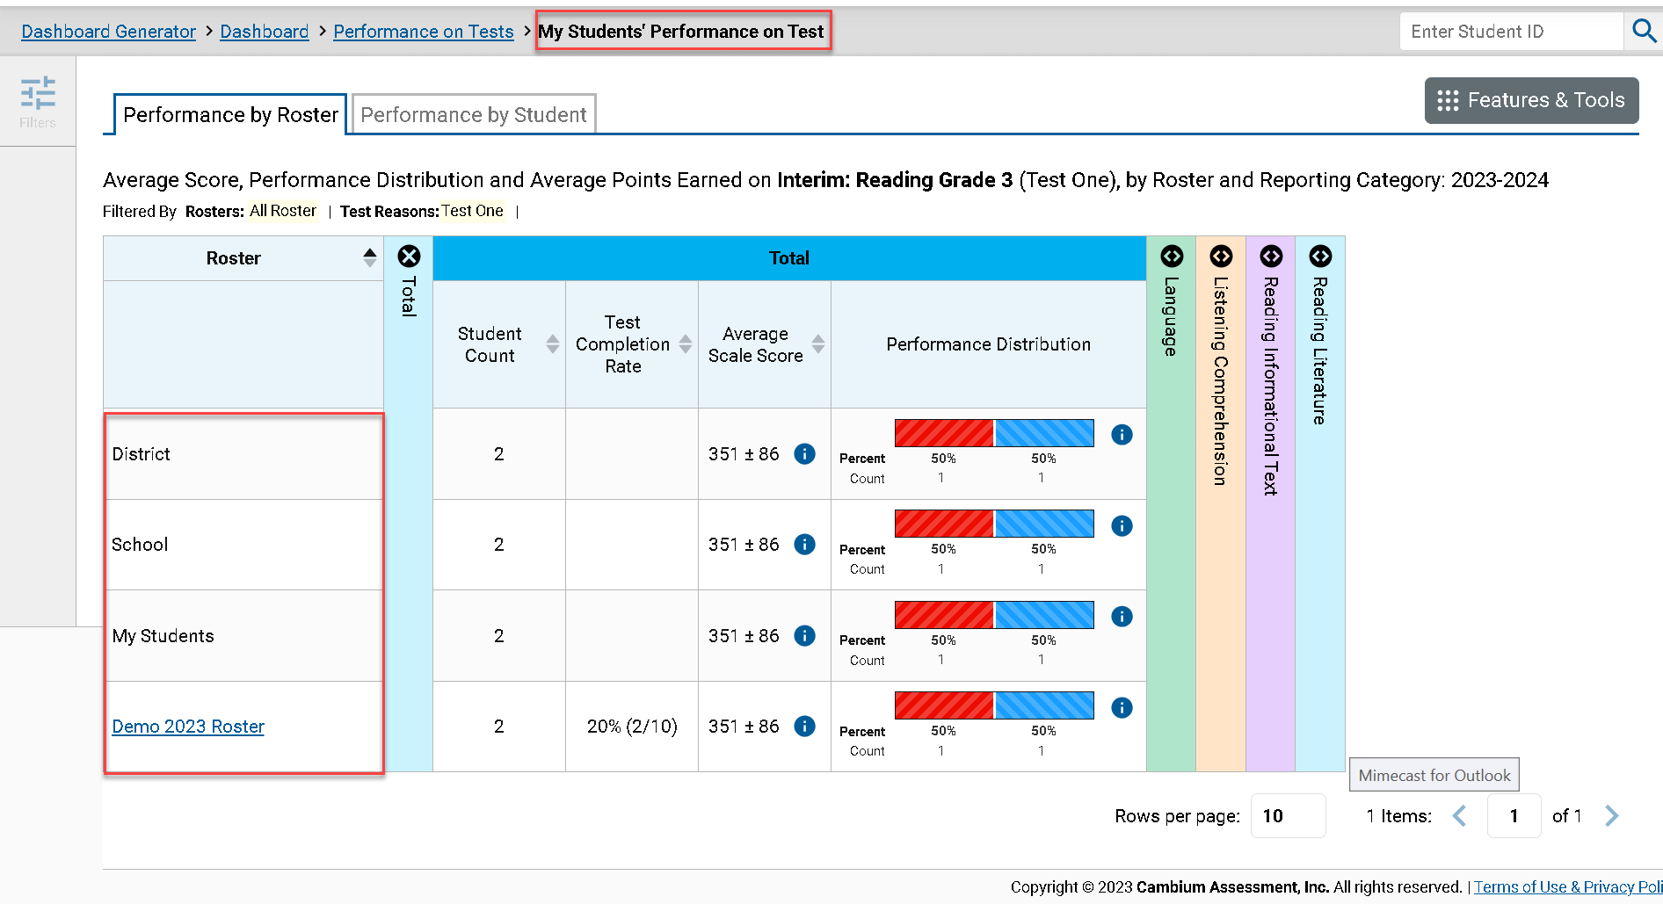
The My Students’ Performance on Test Report—by Roster
Notes:
This is a My Students’ Performance on Test report for a teacher who clicked on the Grade 3 Reading assessment from their Performance on Tests report. The My Students’ Performance on Test table lists the class rosters in the left column with the State, District, School, and My Students comparison rows above. You can toggle to Performance by Student to see all the students in all the rosters listed.

Slide 20
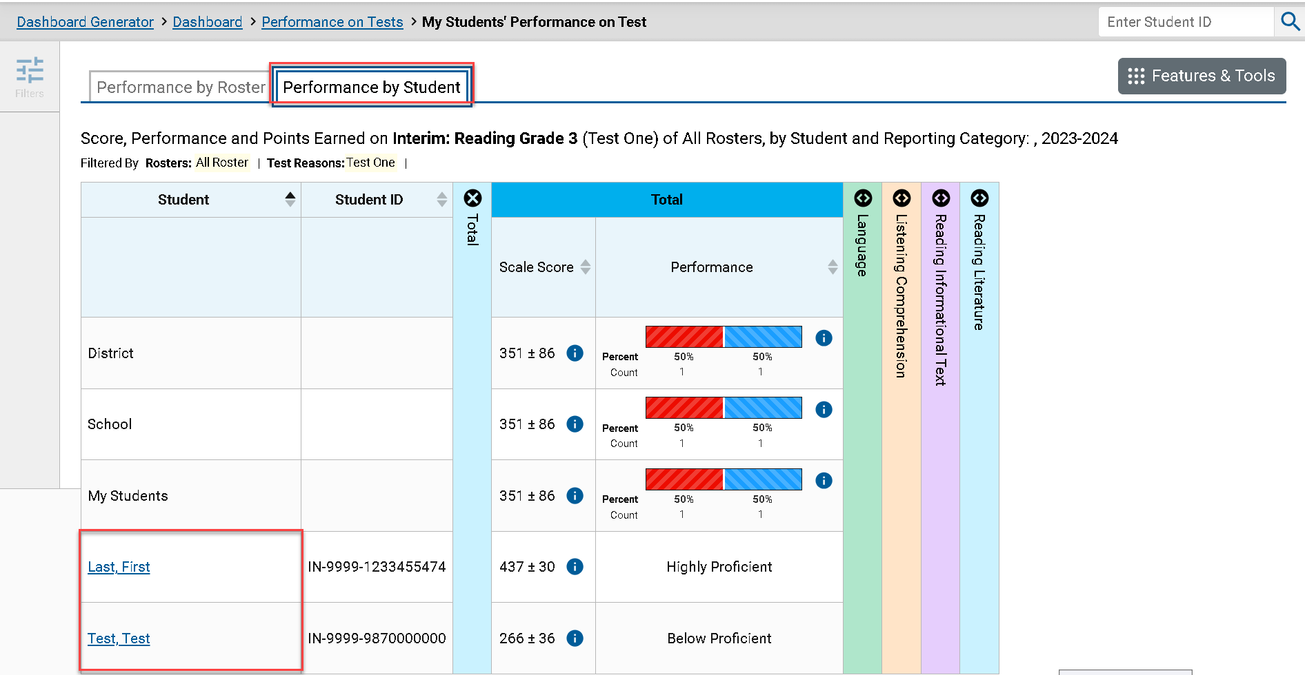
The My Students’ Performance on Test Report—Student Tab
Notes:
Here is the same My Students’ Performance on Test report, organized by student. Click on a Student name or the magnifying glass view button to the left to display the Student Performance on Test report.

Slide 21
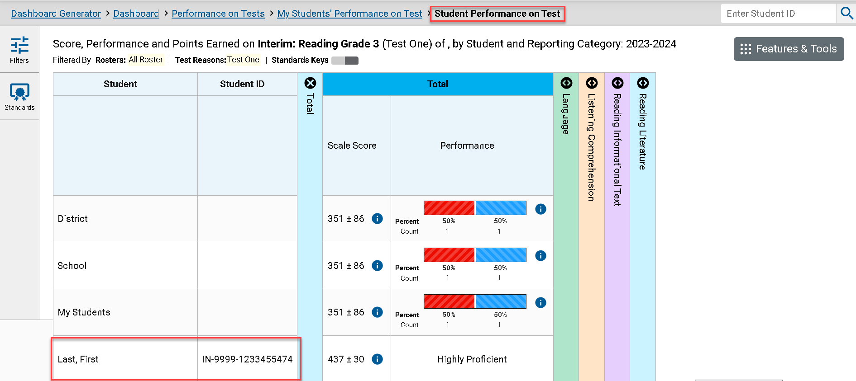
Student Performance on Test
Notes:
This Student Performance on Test report is the end of the navigation trail for a teacher.

Slide 22
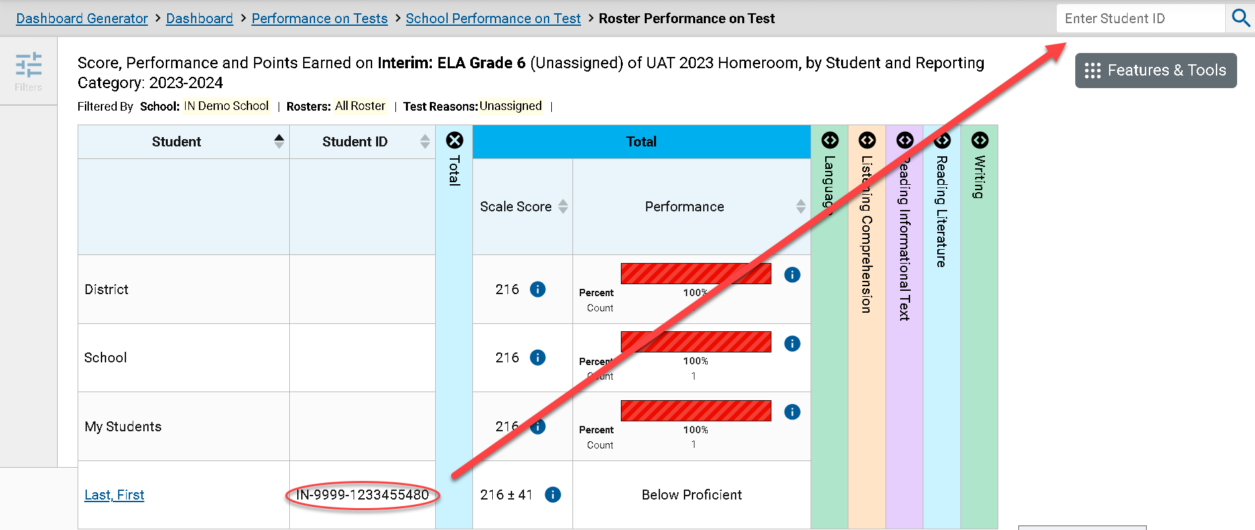
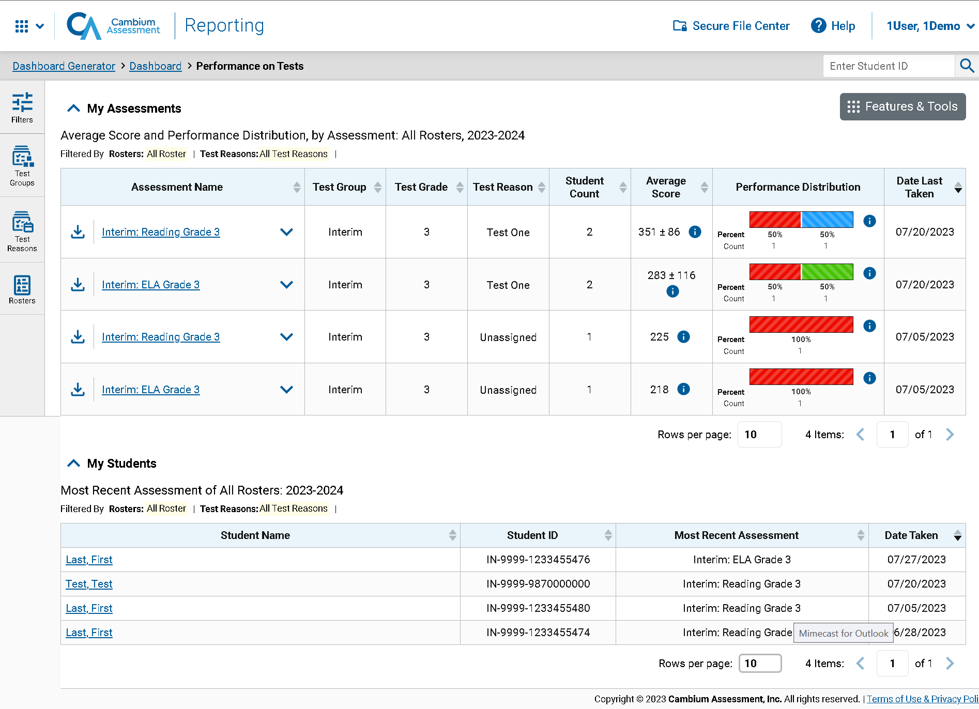
Access the Student Portfolio Report
Notes:
All users can access the standalone Student Portfolio report from any test report page. Copy and paste the student ID number into the search box and then click the search button, as shown in the upper-left image.
Teachers have a fast pass to this report from their My Students table on their Performance on Tests report page. Simply click the student’s and the report displays.

Slide 23
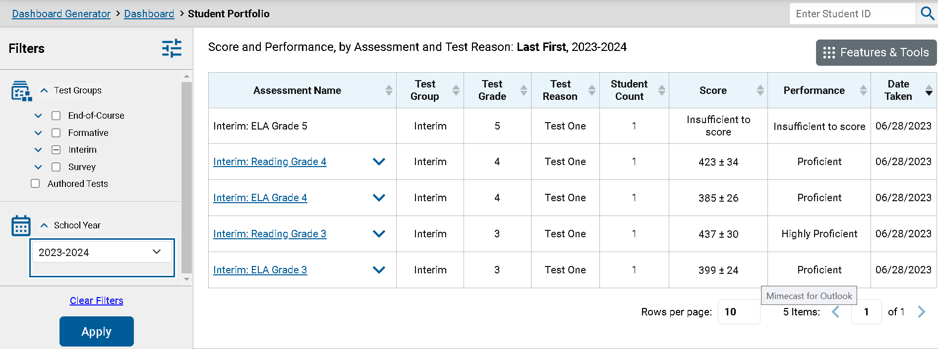
Ways to Use the Student Portfolio Report
Notes:
The Student Portfolio report lists all the tests the student has taken in the current school year.
This report is designed so that users can quickly:
Add tests from previous school years to get a complete list of all tests taken by the student.
Filter by Test Group to eliminate test groups you don’t need to see.
Compare a student’s results with district-, school-, and/or teacher-level data using the expansion arrows to the right of each assessment name.
4. Sort results in any column with a set of sorting arrows in the header.
5. Generate and print an ISR or a Student Data File using the Features & Tools button.
And access specific test data directly from the report by clicking the Assessment Name or the magnifying glass button to the left of it.

Slide 24
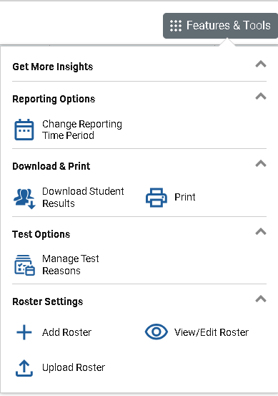
Download & Print Features
Two Types of Results
Individual Student Reports (ISRs)
The Student Data File
Notes:
The Features & Tools menu is available at the upper-right corner of every page in Reporting. The actions displayed here vary, depending on the type of assessment and the user’s role. This section covers how to print reports and how to download student results in the form of Individual Student Reports (ISRs) and the Student Data File.

Slide 25
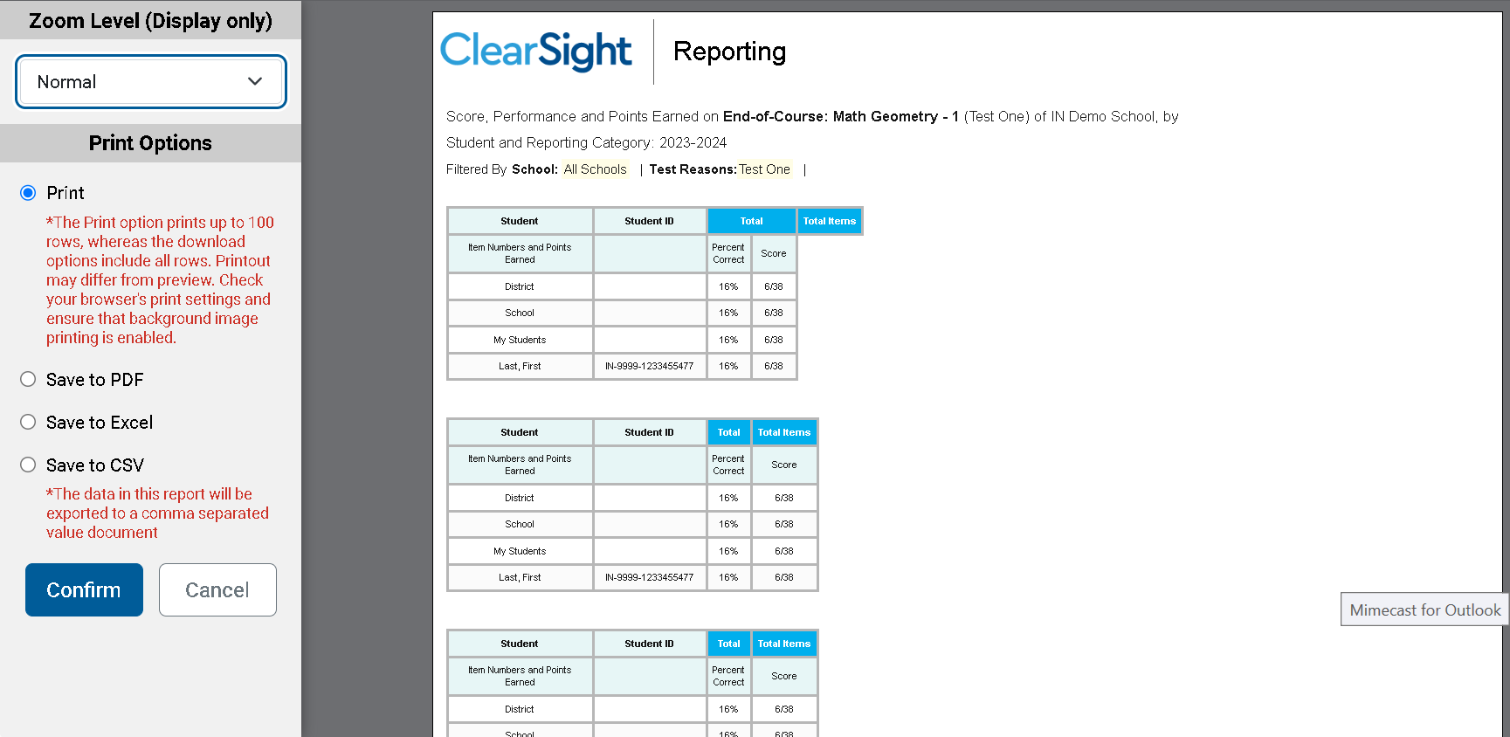
Print Anything You See on Your Screen
Notes:
You can order a print file from any page in Reporting except the Dashboard Generator. You are presented with Zoom Level and Print Options and a preview of what will print. Make your selections from the gray panel on the left side of the page and click Confirm. If you save to PDF, Excel, or CSV, the file is stored in your Secure File Center for 29 days. Here, you see a print preview of the My Students’ Performance on Test report for an End of Course Geometry test.

Slide 26
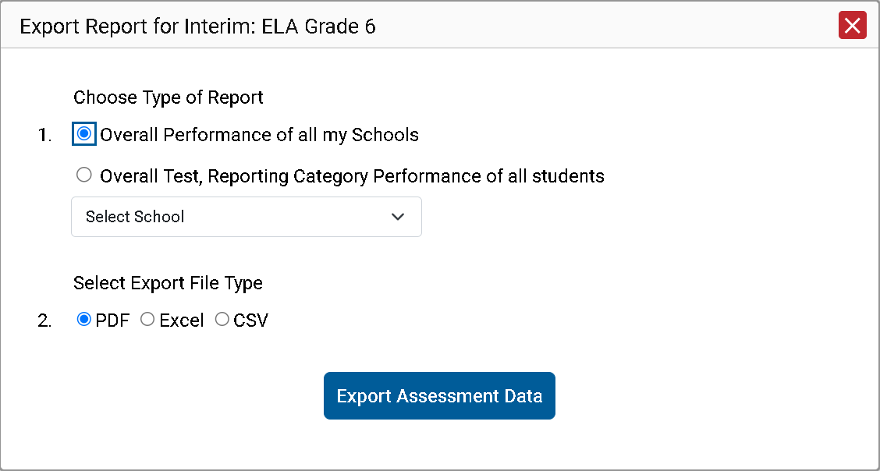
Export Options
Notes:
You can export data from any report where you see the export icon located to the left of the Assessment Name. Your export options will depend on the test report type. You may have the option of selecting summary reports including just the reporting category performance, or you may choose to export them with the item performance of all students included. Make your Export File Type selections and click Export Assessment Data.

Slide 27
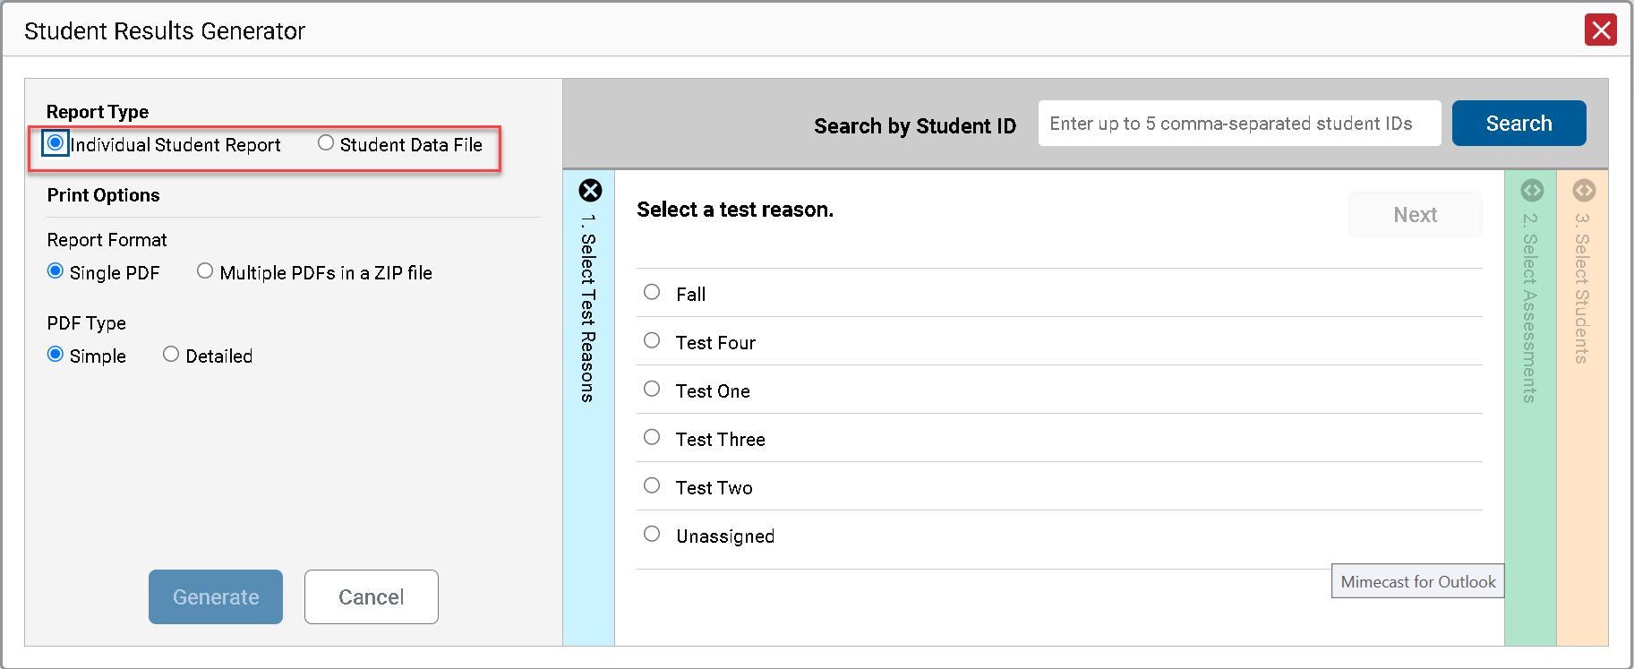
Build ISRs and Student Data Files/Test Reasons
Notes:
The Download Student Results button allows you to generate an Individual Student Report (ISR) or a Student Data File. An ISR is a PDF that displays test results for a single test opportunity taken by a student. It may consist of a single page or multiple pages. ISRs are useful for sharing performance information with students and their parents and guardians. A Student Data File is an Excel, CSV, or text file of the information used for analysis.
The Student Results Generator button is the “head and shoulders” icon located in the Features & Tools menu, under the Download & Print options. It is labelled Download Student Results. When you click it, the Student Results Generator pop-up window displays. Both reports, the ISR and the Student Data File, are typically built by completing three numbered and colored sections:
#1 Select Test Reasons
#2 Select Assessments
#3 Select Students.
In this section, we take you through the steps of generating an ISR. You construct the Student Data File in the same way, but your report will be in the form of an Excel, CSV, or text spreadsheet.
Here is the Student Results Generator window showing pre-populated or pre-selected options, although you can change those selections to match your needs. This slide shows the window for a teacher who is viewing the roster results for Grade 3 Mathematics, taken in Sample administration 1.
Test Reasons are typically test administration windows. They can also be categories, like Pre-test or Post-test, or a numbered opportunity. Select the test reason you need. You can only select one test reason.
Now, go to the other two sections and confirm or change the selections. You open and close each column by clicking the + or - symbols at the top of the columns, or you can click the Previous and Next buttons at the top of each open column.

Slide 28
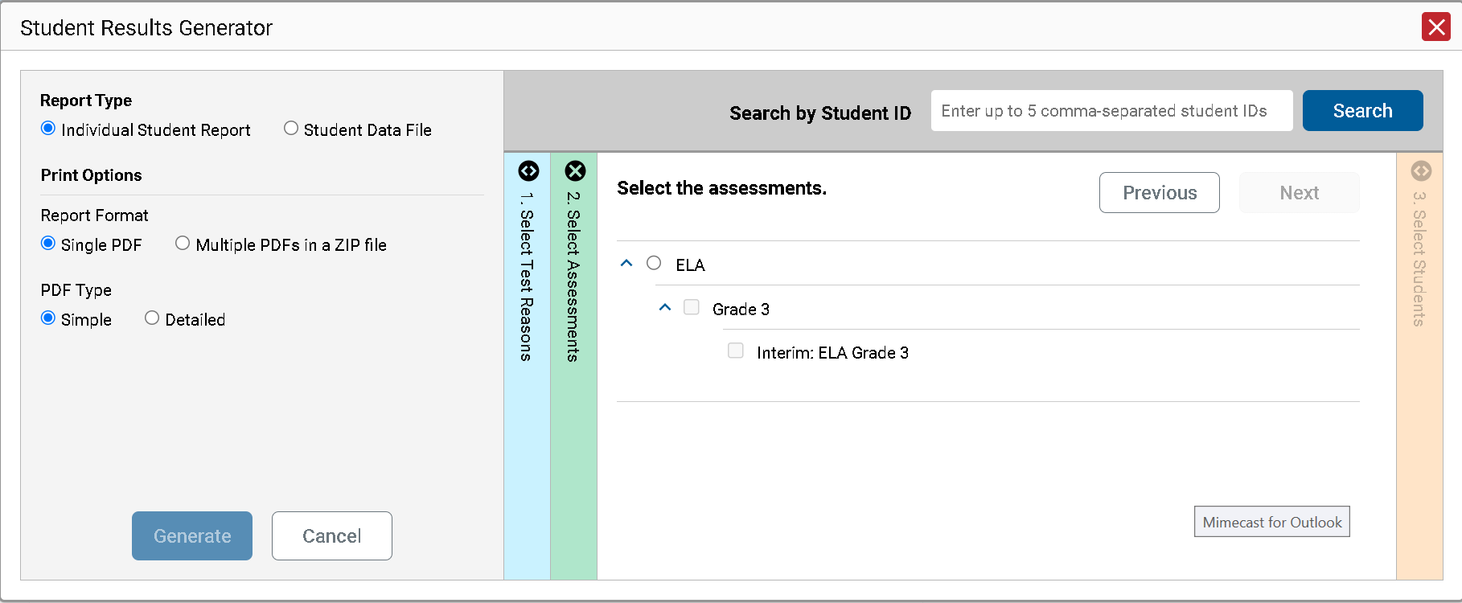
Select the Assessments
2. Select the Assessments
Notes:
Column 2 lists assessments by subject and grade. Select individual assessments or subjects. When you are generating ISRs you can select multiple grades under ONE subject, but not multiple subjects.

Slide 29
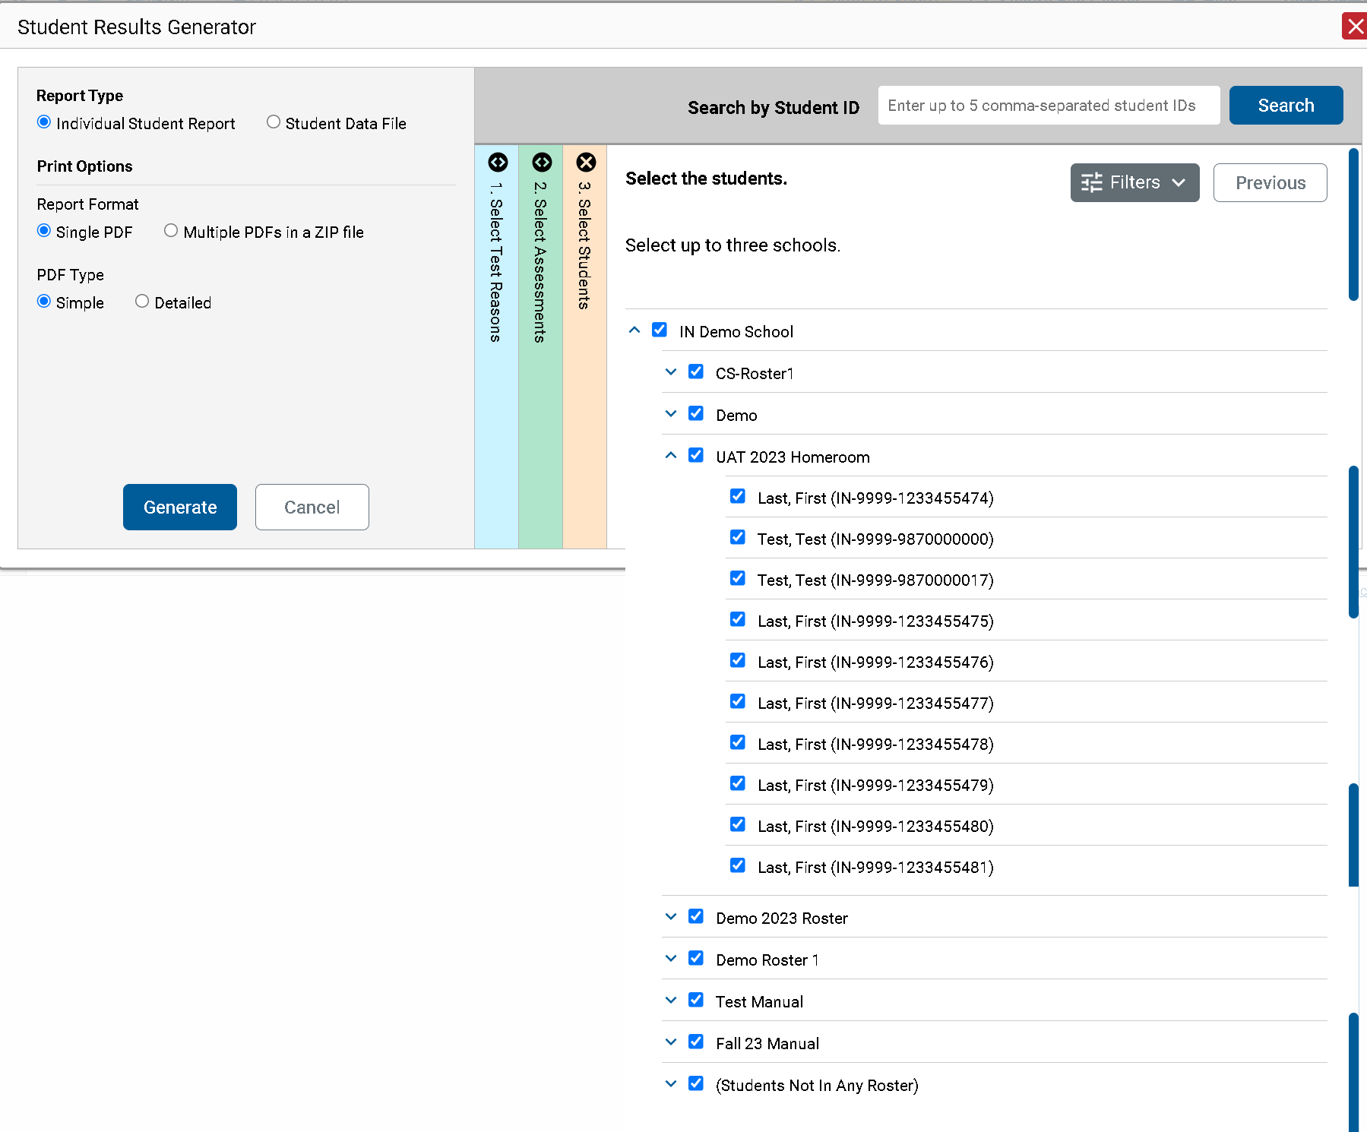
Select the Students
3. Select the students.
Notes:
Column 3 is labeled Select Students. The Select Students column displays the rosters in the Demo School. Each roster can be expanded to show the students on that roster by clicking on the arrow next to the roster name.
District assessment coordinators are limited to selecting students from up to THREE schools only.

Slide 30
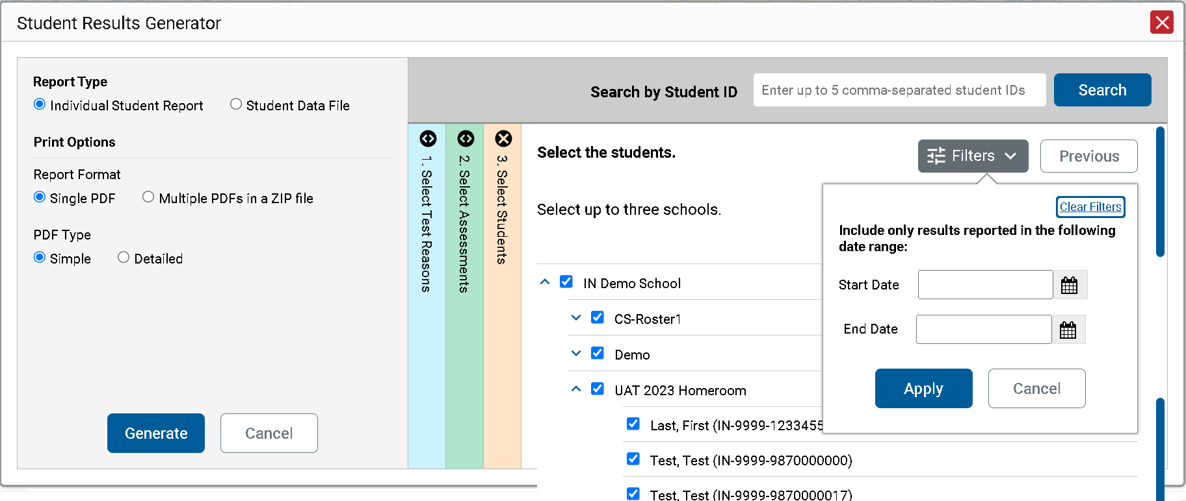
Optional Date Range
4. Set Date Range
Notes:
Another customizing option is accessed via the Filters button which is in the Select Students section to the left of the Previous button. You can select a range of dates to be included in the ISR by using the calendar to enter a start date and an end date. Click Apply. After making your customizations, click the green Generate button and the ISR(s) will post to your Secure File Center.

Slide 31
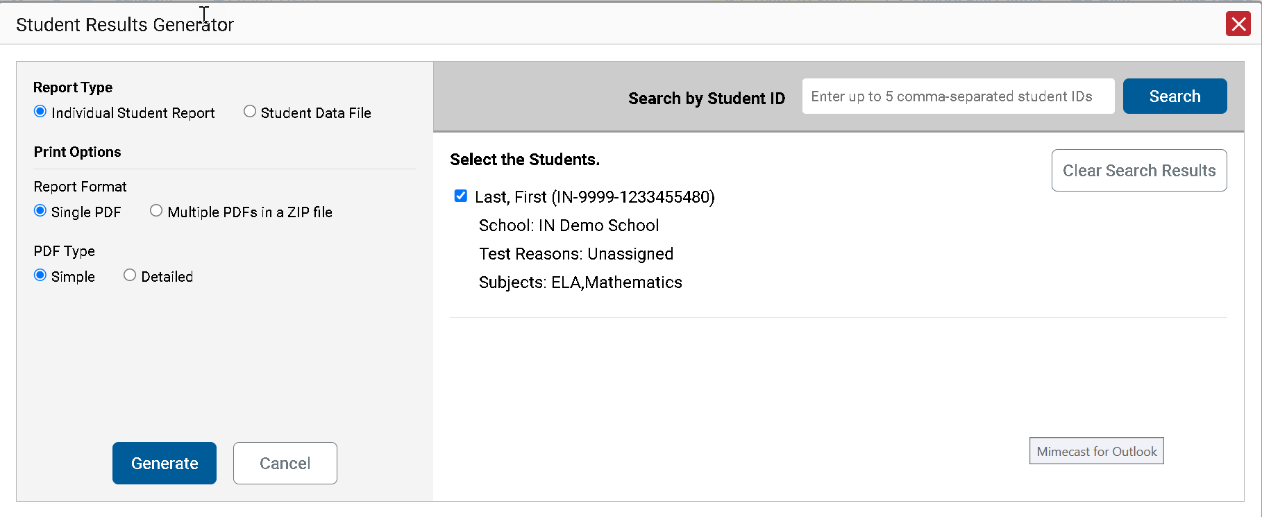
ISR from the Student Portfolio Report
Notes:
If you click the Download Student Results button from the Student Portfolio Report, the data will load pre-populated, as shown here, without the three colored panels. You see the student’s name and ID number, the school, the test reasons which display as test administrations of the current school year, and the subject, Mathematics. You can clear the Student Portfolio selection by clicking Clear Search Results. That removes the selected student and takes you to the three panels you can select from, with nothing pre-selected.
When you click the green Generate button, the report will post to your Secure File Center.
If you need to print just a few more student’s ISRs, you can enter up to five, comma-separated student IDs in the Search by Student ID box, and the same pre-populated template will display, allowing you to generate the ISRs for all those students’ tests.

Slide 32
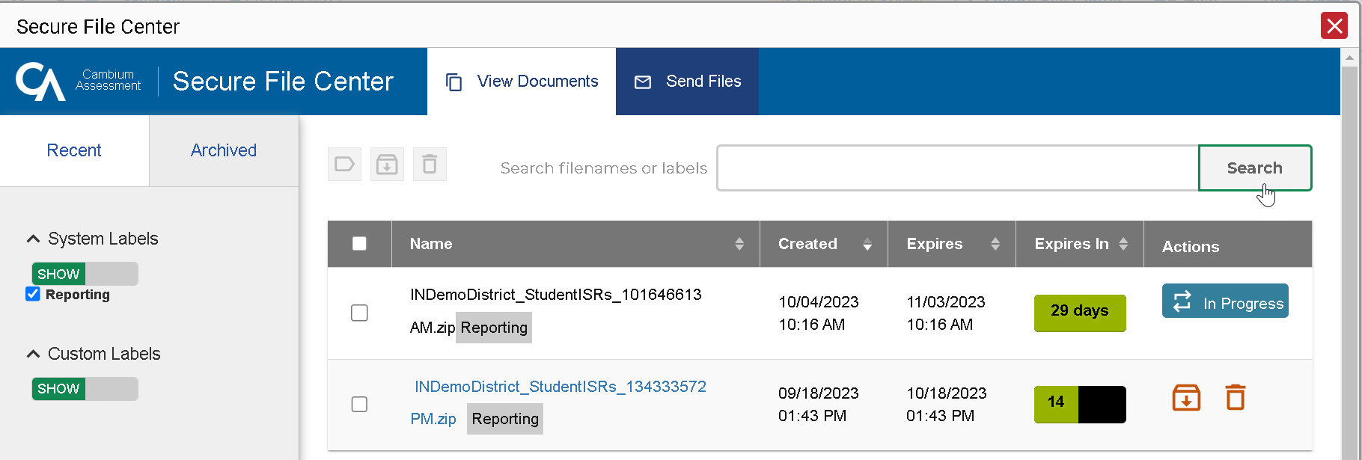
Secure Inbox
Notes:
Here is a sample Inbox showing multiple ISR postings. You can archive or delete a file at any time by using the buttons under the Actions column in the results table. Click on the name of a file to download it to your computer.
Files are automatically deleted after 29 days in both the Secure File Center and the Archived boxes.

Slide 33
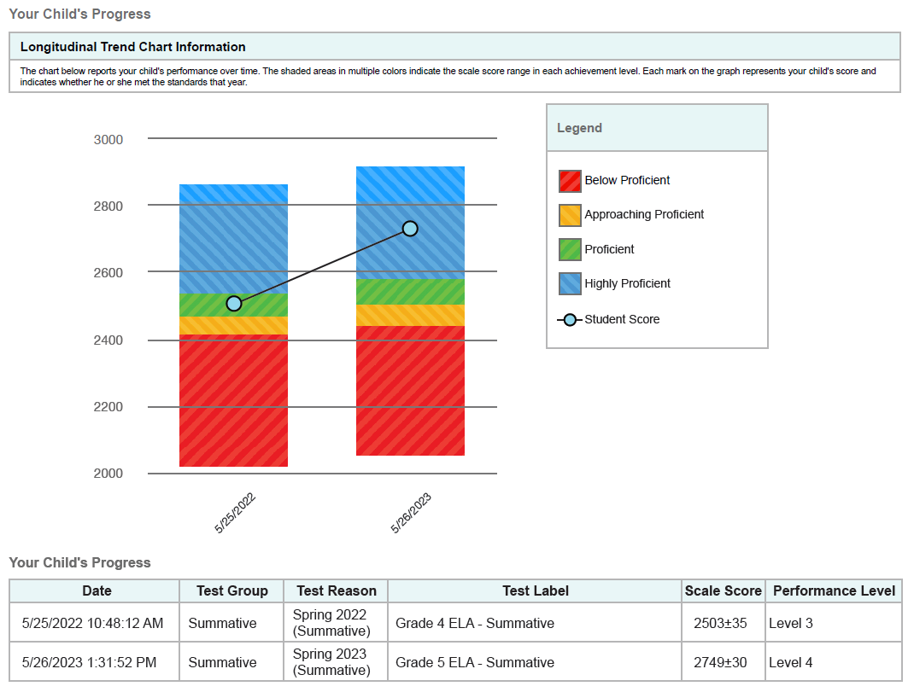
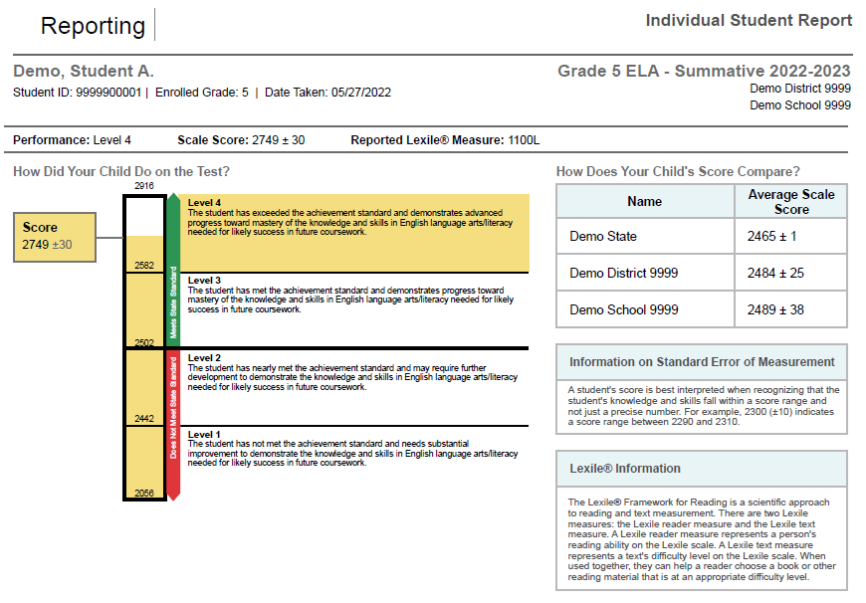
Sample Simple and Detailed Individual Student Reports
Simple ISR
Detailed ISR
Notes:
Here is a sample ISR. You can order a simple report or the more detailed report. The detailed report may include a longitudinal trend chart section, like the one shown here if a student has taken the same type of test or exact same test multiple times. You can see the student’s progress over time as the three tests results display as performance level and scale score.
The Detailed ISRs will also show the student’s

Slide 34
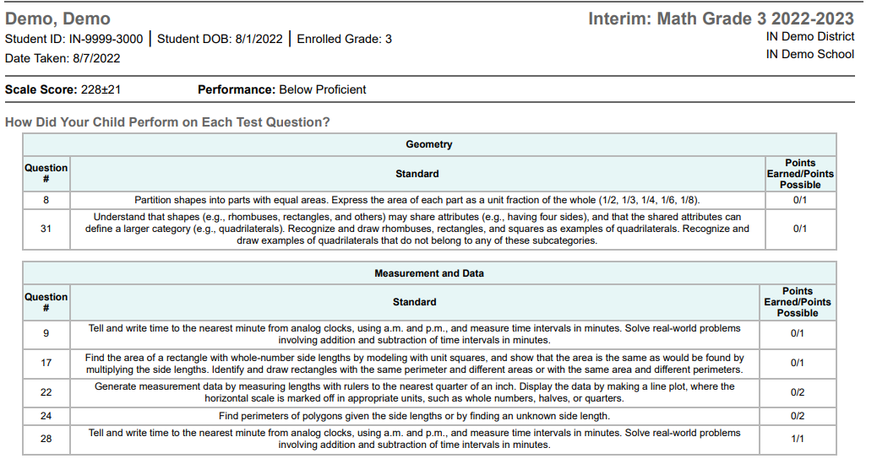
Sample Detailed Individual Student Report
Detailed ISR
Notes:
The Detailed ISRs will also show how many points a student earned per question, as well as the standard that each question assessed across each Reporting Category.

Slide 35
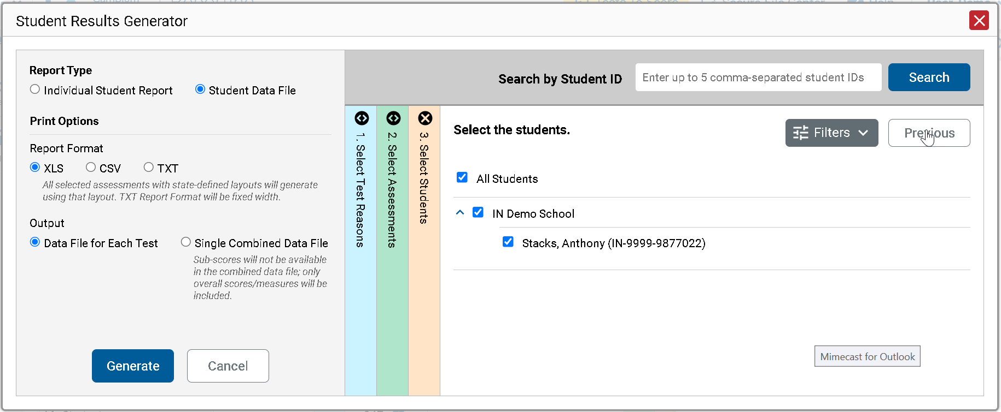
Generate a Student Data File
Student Data File—
Excel Worksheet
Notes:
A Student Data File is a user report of performance data, in Excel, CSV, or text format. Files of this nature allow the user to employ the workbook features of a spreadsheet application to organize and sort the data. The generation process for a Student Data File is the same one used for the ISR with different print options, with fewer restrictions. You can select tests in as many subjects as you want.
Customize the Student Data File using the same three selection columns and the Filters button. Choose your desired export format and click the green Generate button. The Student Data File displays in the user’s Inbox. A sample file is shown here.

Slide 36
Generating ISRs and Student Data Files
ISRs
Student Data Files
One test reason
A single subject; multiple grades
Up to 3 schools for district-level users
One test reason
Multiple subjects; multiple grades
Multiple schools in a district
Data file for each test or combined data file
Notes:
Here is a review of the parameters of the options for each type of file, ISRs and Student Data Files.

Slide 37
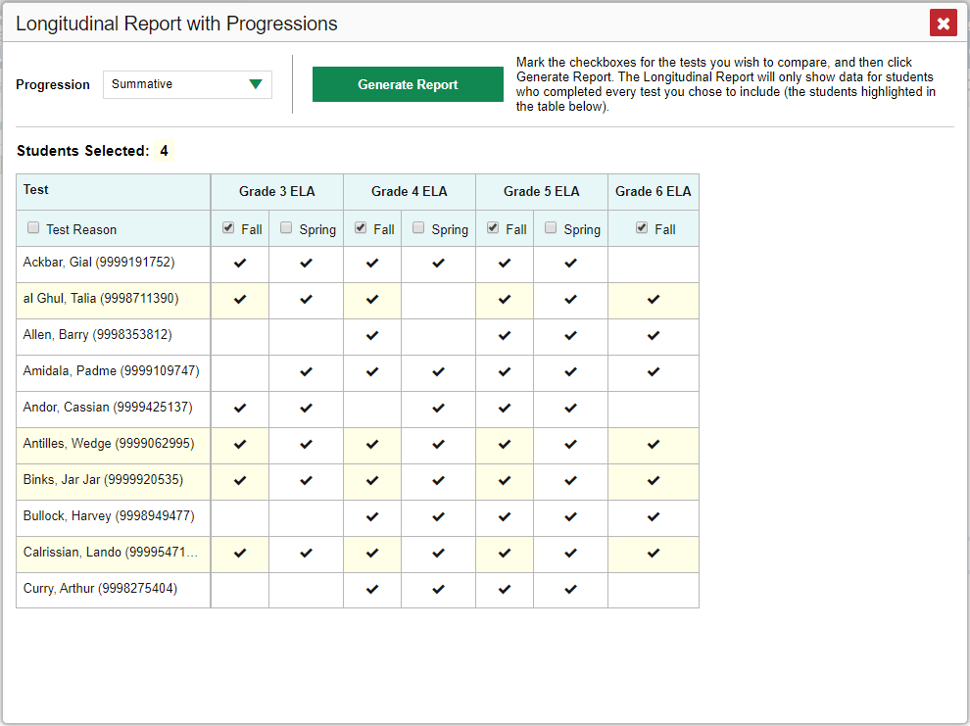
Longitudinal Report
Only students highlighted in yellow will appear on the Longitudinal Report.
Notes:
When multiple tests are related and have been linked in the system, a Build Longitudinal Report button will display in the Features & Tools menu. Depending on your role, the test types, and the number of students in the report, it may display a report options page rather than the Longitudinal Report itself. If you are viewing a Longitudinal Report for which both Interims and Summatives are available, the Progression drop-down list appears, allowing you to select Summatives only, Interims only, or a combination of both test types.
Click the green drop-down arrow to select summative tests only, interim tests only, or a combination of both. Then click the green Generate Report button.
Teachers viewing a longitudinal report for multiple students are presented with a Longitudinal Report with Progression pop-up window. The Progression drop-down menu is located at the top of the window followed by a table of their students and the related tests. Each test appears in its own column, with sub-columns below for each test reason (categories of tests, or for a summative, a testing window).
The cells in the columns display checkmarks to indicate which students completed which test and test reason combinations. The students highlighted in yellow have completed all of the related tests and will appear on the longitudinal report unless you change the tests you want included in the report.
Mark the checkbox for each test/test reason combination you wish to include in the report. Mark the Test Reason checkbox on the left to include all test reasons or clear it to remove all. Click the green Generate Report button at the top of the window to view the Longitudinal Report

Slide 38
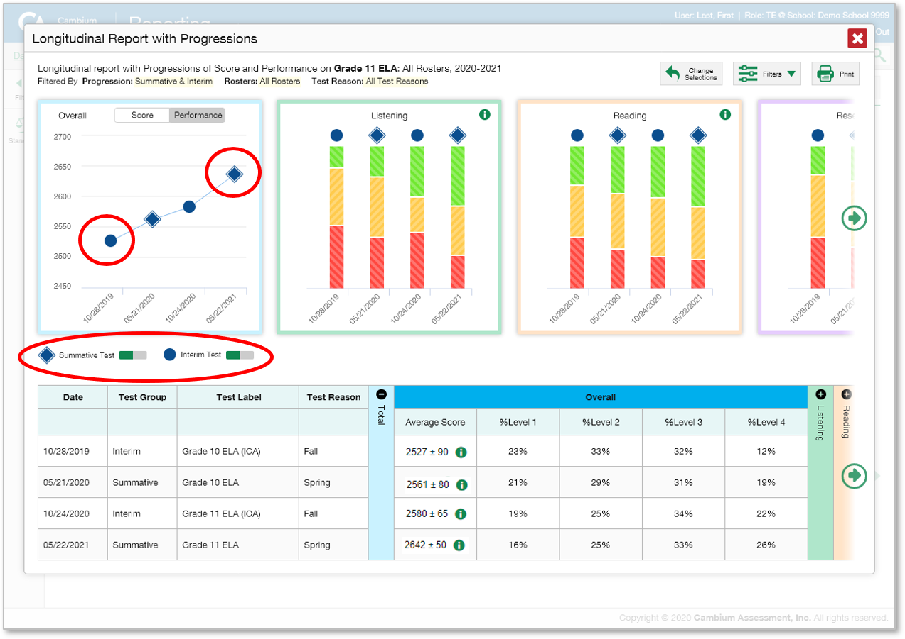
Longitudinal Report for Multiple Students, Multiple Test Types, & Reporting Categories
Notes:
Here is a sample Longitudinal Report with Progressions example for multiple students who took multiple related test types (Grade 10 and Grade 11 Interim ELA and Summative ELA), displaying with reporting categories. Score data are plotted along a line. A symbol appears on each data point. When multiple test types are present, refer to the legend immediately below the graphs to find out which symbols correspond to which types of tests. You can click the test type toggles in the legend to hide or show data for each one. To help you distinguish between test types, the interim test is identified with a blue circle and the summative test is identified with a blue diamond.
Performance-level data are shown either the same way or, for multiple students, in performance distribution bars, similar to the reporting category graphs which allow you to see, at a glance, how students are improving or declining in each area of the test. Hover over the data points in a line graph or the sections in a bar to get more information.
Alternatively, in the table at the bottom of the report, the data are replicated, with expandable columns for the reporting categories.

Slide 39
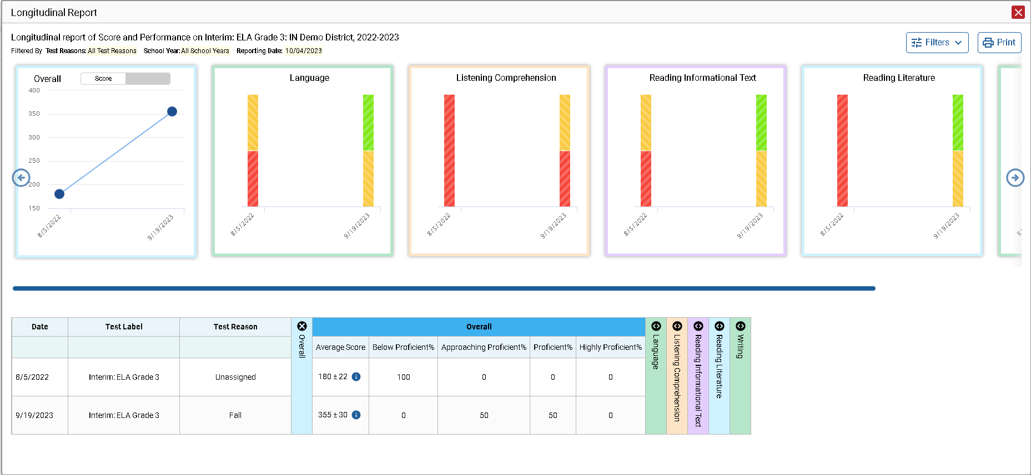
The Longitudinal Report—Scores Over Time - Interim
Notes:
Here is a sample Longitudinal Report for a student who took the Grade 3 ELA test on two opportunities across 2 terms.
The graph in the upper-left corner of the report shows the scores for both opportunities. If you hover over the point, you can see the score displayed for each administration of the test. The first score was 180, and the second score was 355. The information in the graph is mirrored in the table below.
Toggle the switch at the top of the graph to see the results by Performance Level.

Slide 40
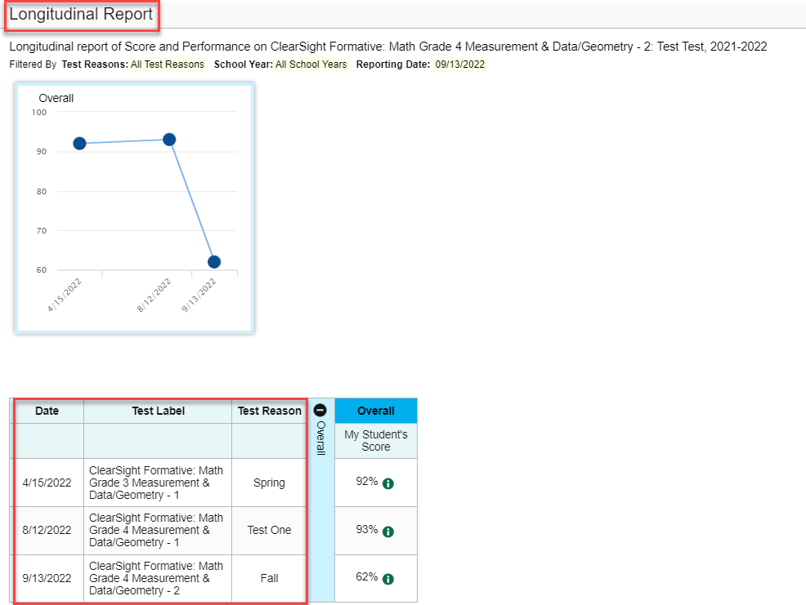
The Longitudinal Report—Scores Over Time - Formative
Notes:
Here is a sample Longitudinal Report for a student who took the Grade 3 Mathematics test on two opportunities in the spring test administration.
The graph in the upper-left corner of the report shows the scores for both opportunities. If you hover over the point, you can see the score displayed for each administration of the test. The first score was 1276, and the second score was 1475. The information in the graph is mirrored in the table below.
Toggle the switch at the top of the graph to see the results by Performance Level.

Slide 41
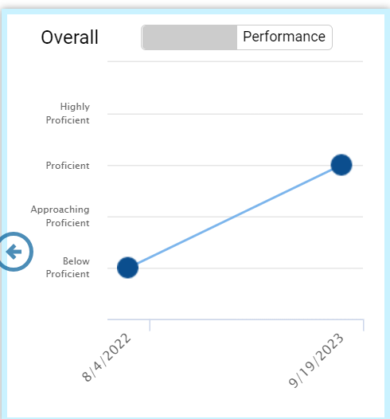
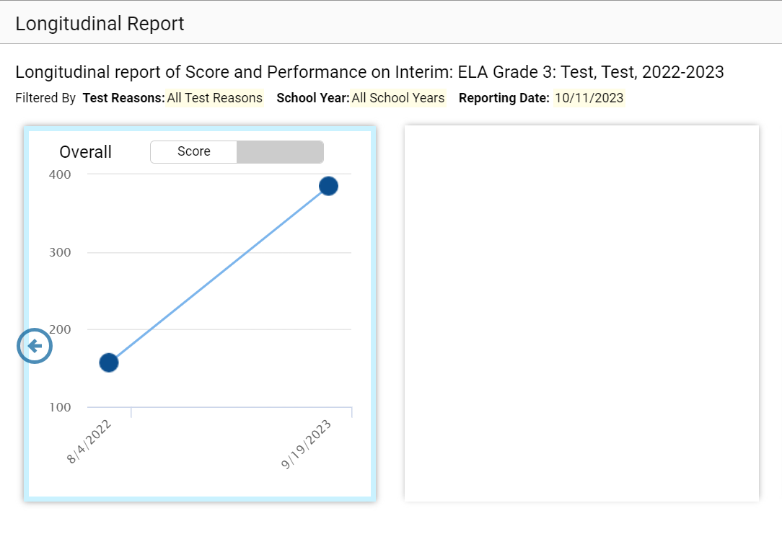
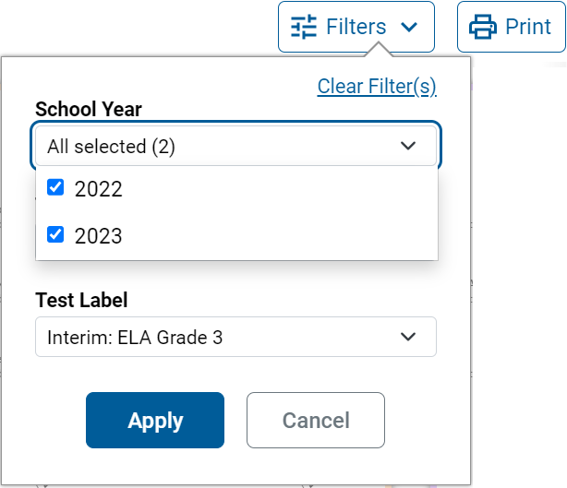
The Longitudinal Report—Performance Over Time
School Year: By default, data are shown for all years. Selecting a date, such as “2022,” will filter the results for the 2022—2023 school year results.
Test Reason: Most helpful for numerous interim and benchmark tests that can be screened by category, omitting those you do not need to see..
Test Label: Deselect the names of the tests you don’t need to see.
Notes:
Now, on the graph, you see that the student remained in the Did Not Meet Grade Level performance measure over time.
You may want to filter a Longitudinal Report in order to focus on some test opportunities and not others.
Note that filtering tests may affect the set of students whose data are included in the report.
Open the filter menu at the upper-right corner and select the filter options you prefer from the drop-down lists.
You may want to filter by a particular school year or years. By default, Longitudinal Reports show data for all years. Longitudinal Reports can show student performance from a time when the students were not yet associated with you. For example, if you are a seventh-grade teacher, you can use these reports to view your current students’ performance on last year’s sixth-grade tests.
If the report includes interim assessments, you may wish to filter by a test reason (a category of test), which means excluding all other test reasons from the data. For example, you may want to narrow the report down to show only tests taken in the spring. For summative assessments, test reasons are the same as testing windows and are not useful.
Finally, you may find that certain individual tests are less relevant than others. In that case, you can use the Test Label options to deselect the names of the tests you don’t want to see.
Click Apply.

Slide 42
Longitudinal Reports—Ways to Customize
Results from current and previous school years
Filter options: school year, test reason, test label
INDIVIDUAL REPORTS
GROUP REPORTS
Multiple instances of the same test (interims and benchmarks)
Related tests (typically related by standard and determined by school/district administration)
Students who completed the same test multiple times (interims and benchmarks)
Students who completed related tests
Notes:
To review, you can set up your Longitudinal Reports using results from current and previous school years. Three filter options (school year, test reason, and test label) allow you to drill down into a Longitudinal Report to access specific data relevant to your needs.

Slide 43
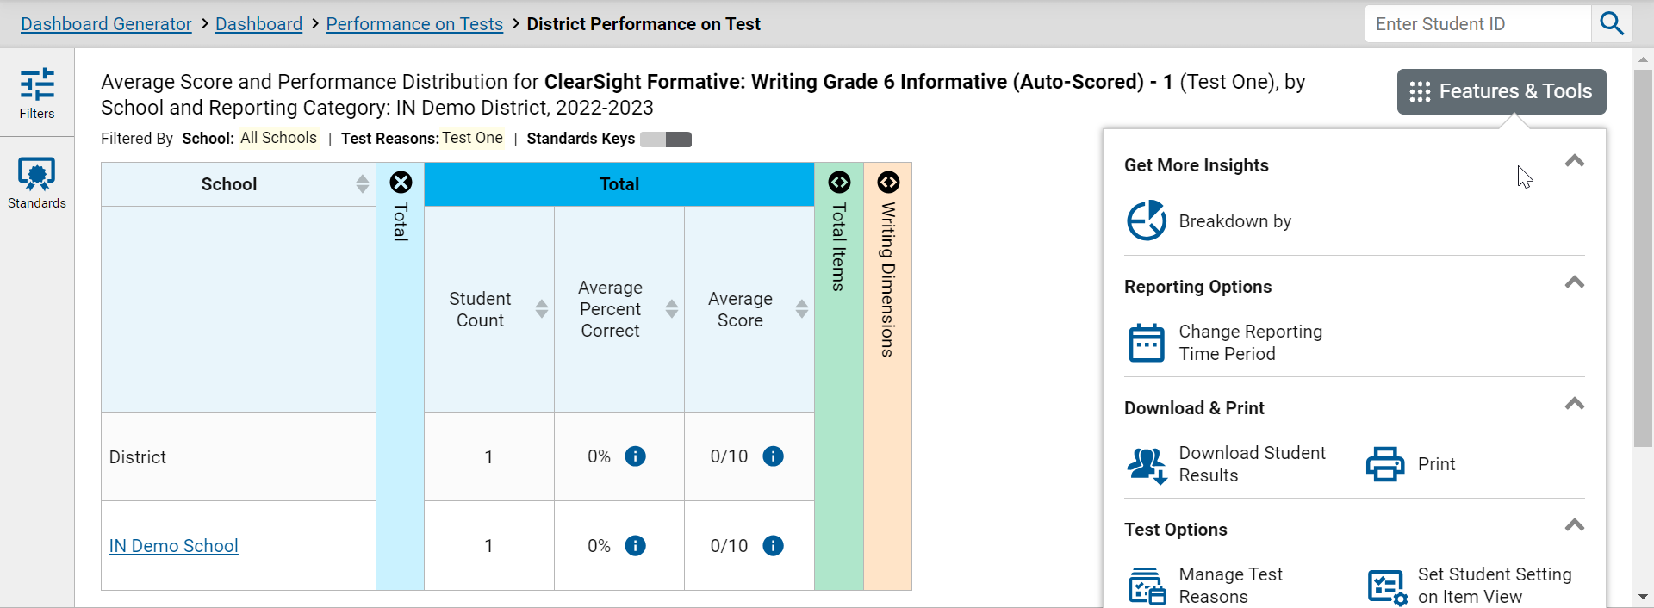
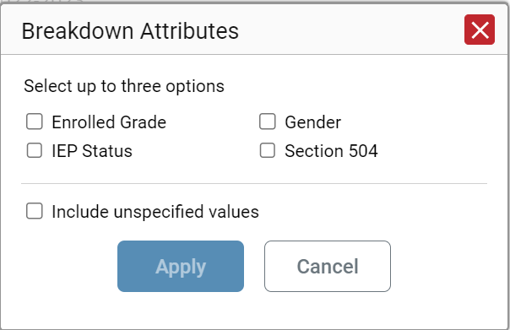
How to Build a Demographic Breakdown Report
Notes:
There is a tool that allows users to break down data by demographic sub-group. You can create a breakdown report from any page in Reporting that displays data for multiple students. Open the Features & Tools menu and click the Breakdown by button. A Breakdown Attributes window opens, displaying the options available to you.
For example, here, you see a School Performance on Test report for the Grade 8 Mathematics test. You can build a report for a specific group of students based on any three attributes listed in the Breakdown Attributes window.
For a sample report, the English Language Learner (ELL) Status, Enrolled Grade, and Section 504 options have been selected. A checkbox is displayed next to the term, “Include unspecified values”. This option, when selected, will include any of the user’s students with no demographic information assigned to them in TIDE. Click Apply. The customized report displays, as shown on the next slide.

Slide 44
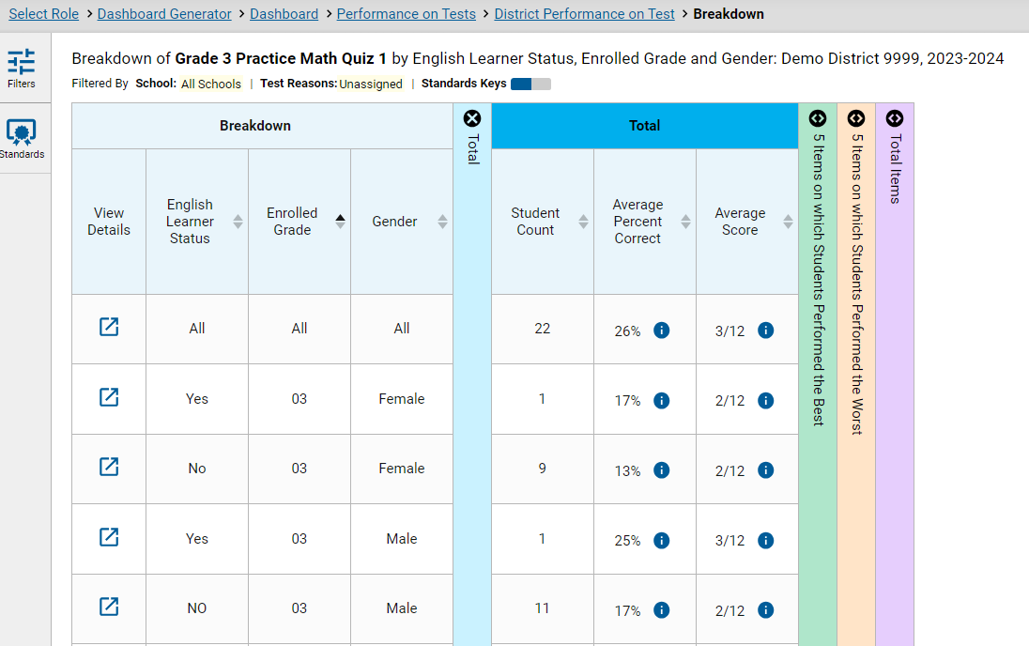
Demographic Breakdown Report
Notes:
The Breakdown page is organized according to the combinations selected. A row appears for each possible sub-group combination. The number of rows in the table will depend on how the students fall into the demographic categories.
For example, here you see a row for ALL the students, followed by some possible combinations. If a combination does not appear in the table, it means none of the students fall into that sub-group. Notice that the table header has updated to reflect the chosen attributes. You see from this breakdown report that there are 22 students who are divided into four sub-groups. You can sort the sub-groups in a few different ways -- by English Learner Status, Enrolled Grade, and Gender. To look closer into a specific sub-group, click the View Details button in that row.

Slide 45
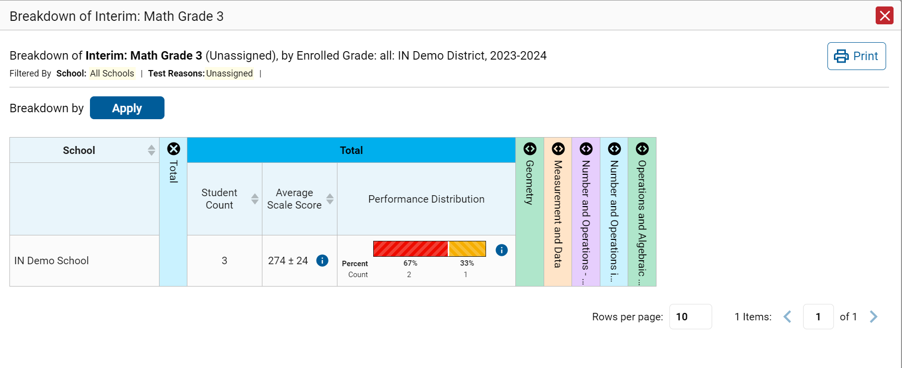
View Details Window/Breakdown Report
Notes:
A Breakdown window opens, displaying detailed results for that sub-group. A row of drop-down menu buttons appears above the table, displaying the attributes of the group you chose. To quickly transition to another demographic sub-group for the same test, you can apply the breakdown menu options that display above the table of results. Select an attribute you want from the drop-down menus and click Apply. The new sub-group will display.

Slide 46
Use More Advanced Features
Tests with Reporting Categories
View and Interpret Writing Dimension Measures
Work with Interim Reports—Their Items, Rubrics, and Scoring Essentials
Change Reporting Time Period
Manage Test Reasons
Create a Roster
Notes:
Now you have a good understanding of the basic functions of the Reporting system.
More advanced features are explained in this section.

Slide 47
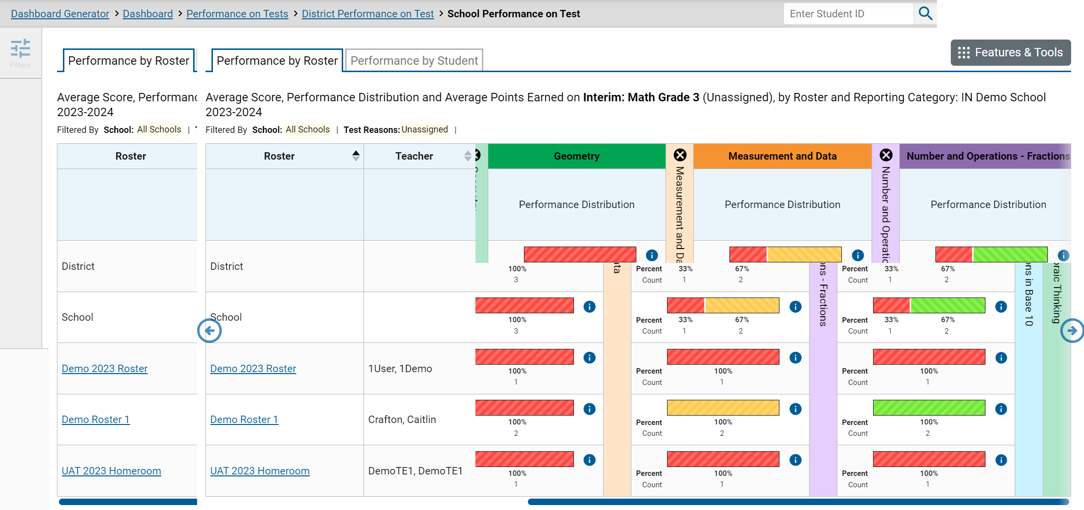
Tests with Reporting Categories
Notes:
For tests with reporting category sections, you can compare the performance of your students in each area of the test. Click each vertical section bar to expand or collapse it. In this example, you can view the performance level for each student under the reporting categories for this Grade 3 Mathematics test. Interim tests cover multiple reporting categories, while a benchmark test covers only one.

Slide 48
Writing Dimensions
Notes:
The Writing Dimensions section appears for aggregate reports of assessments that include an essay component.
The columns within the Writing Dimensions category are nested with the types of essays under the Essay header and Writing Dimensions applicable to that type of essay below. Each dimension sub-column is split into additional sub-columns based on the possible points students can earn in that dimension. These point columns show the percentage of students in a roster who earned each point value in each dimension.

Slide 49
Writing Dimensions—High and Low Point Values
Notes:
To help you analyze your students’ performance in the different dimensions, certain cells are highlighted green or red. The cell with the highest percentage of students earning the highest point value for a dimension is shaded green and displays an up arrow in the cell. These students performed well in that dimension as compared with other students. The cell with the highest percentage of students earning the lowest point value for a dimension is shaded red and displays a down arrow. These students performed comparatively poorly.
For example, you can quickly see that the teacher’s students, overall, are scoring low in Elaboration. The red shading serves as a red flag. The goal is to help users identify a pattern where students are not doing so well. These markers allow users to detect a pattern. And even if there is no pattern, it allows the user to focus on areas that need remediation and to figure out what is working well and can be shared across classes.
You can also see that the students on the Demo Roster are scoring high in Conventions. The green shading indicates consistent, strong performance. The teacher can determine what is working well and can be shared across classes.

Slide 50
Writing Dimensions—Information Legends
Notes:
The legend for each type of essay describes the dimensions that are measured for that essay. Each dimension is identified by ID number in the legend.

Slide 51
Writing Dimensions—High and Low Point Values
Notes:
To help you analyze your students’ performance in the different dimensions, certain cells are highlighted green or red. The cell with the highest percentage of students earning the highest point value for a dimension is shaded green and displays an up arrow in the cell. These students performed well in that dimension as compared with other students. The cell with the highest percentage of students earning the lowest point value for a dimension is shaded red and displays a down arrow. These students performed comparatively poorly.
For example, look at the three dimensions measured under the Informative/Explanatory type of essay. The students in Roster AV did well in all three dimensions, with over half of the students earning the maximum point values, at 54%, 59%, and 67%.
Compare that with Roster DE, where 51% of the students got 1 point in Purpose, Focus, and Organization, which is the lowest point value, and 63% earned 0 points in the third dimension. The shading serves as a red flag. The goal is to help users identify a pattern where Roster AV is consistently doing well, across the dimensions, whereas Roster DE is not doing so well. These markers allow users to detect a pattern. And even if there is no pattern, it allows the user to focus on areas that need remediation and to figure out what is working well and can be shared across classes.

Slide 52
Types of Non-Summative Tests that Report Item-Level Data
All Tests
Interim Tests
—Adaptive tests that cover some or all of the standards students are required to learn
—Users can see item-level scores for individual students who took an adaptive interim
Formative Tests
—Fixed-form tests within a specific reporting category (topic or skill area)
—Users can compare item-level scores across all students
Our Focus:
Item-Level Data Included on Formative and Interim Test Reports
Notes:
The focus of this section will be on non-summative test reports that contain item-level data, access to the items themselves, and access to student responses to the items. This chart shows how tests in Reporting can be categorized.
All tests are either summative or non-summative assessments. Summative tests are end-of-year or end-of-course comprehensive tests that assess the student’s command of an entire subject. Non-summative tests vary by state and district and can be divided into benchmark and interim tests.
Benchmarks are small tests in single reporting categories with non-secure items. Users can compare item-level scores and the items themselves for all their students.
Interims are larger than benchmarks but smaller than summative tests. Many interim tests will report item-level data, depending on the type of test and on state and district policies.

Slide 53
Reports with Item-Level Data
Notes:
Here is a Roster Performance on Test report, by student, for students who took the Grade 5 Mathematics Test. The report displays item-level data at the student level, and you can access the items themselves and the student responses to the items.
The first three rows under the section header list the item number, the standard, and the number of possible points.
For example, Demo Student 1 earned 1 out of 1 points on item #6.
In reports with item-level data, you may occasionally see “n/a” instead of a score for an item. It means that the student did not respond to the item, or the item was not included in that form of the test.

Slide 54
How to View Standards for Each Item
Notes:
In a report displaying item-level data, you can view the standard to which each item is aligned. This allows you to determine immediately what the item measures. To show or hide item standards, click the Standards Keys toggle in the row of filter details below the report table heading. The standards display beneath the blue item numbers. Click the more information buttons beside the standard keys to view the legend for each standard.

Slide 55
Reports with Multiple Reporting Categories
Notes:
When data includes reporting categories, you may see sortable columns for Performance level, along with the item-level data in each section, as shown here in this Grade 3 Mathematics test.

Slide 56
Viewing an Item and Student Response
Notes:
To view a test item in a blank, unanswered state, click the item number link in the first row of a report table. The item view window displays the test question as it appeared on the assessment on the Student Testing Site.
To view an item with a student’s response, find that student’s name in the Student column on the left. Then click the blue score link under the numbered item. In this example, we look at item 41 for the last student listed.
The item view window displays the item along with the answer provided by that student.
On the next slide, we will explain the features of an item view window that includes the student’s response.

Slide 57
Item & Score Tab/Rubric & Resources Tab
Notes:
You can see the current item number and the score for that item in the gray bar in the banner. The student answered correctly for a score of 1 out of 1 point on item 3. Moving to the right in the gray bar, you see two tabs, Item & Score and Rubric & Resources. You can toggle between these tabs to display associated content. The Item & Score tab is open in the upper-left image, and the Rubric & Resources tab is open in the lower-right image. Underneath the gray banners, the scoring assertions are displayed with their outcomes.
In the Scoring Assertion column, each assertion states exactly what the student must do to earn points. The Outcome column shows a checkmark for a correct answer, or an X for each incorrect answer. This item has a single scoring assertion.
Below, the test item is displayed along with the student’s response. Reviewing a student’s response may provide clues to the student’s thinking.
You can show or hide a student’s visual settings, like large fonts, different color contrasts, or Spanish language, on a per-item basis. To do so, click the toggle above the item on the right side.
The Rubric & Resources tab has the same banner features and is divided into multiple sections, which may include Details, Resources, Rubric, and Frequency Distribution of Student Responses. The sections are expanded and collapsed using the expansion arrows. The information included in each section varies, depending on the test item.
The Topic lists the skill area to which the item belongs. The Content Alignment section describes, in detail, the academic or learning standard to which the item is aligned.
The Rubric displays the criteria used to score the item. A simple correct answer may be listed, or this section may include a score breakdown, a human-readable rubric, or an exemplar, which provides an example of a response for each point value.
Frequency Distribution of Student Responses provides a breakdown of how many students earned each possible point value available for the item.

Slide 58
Multiple Scoring Assertions
Item Content Redacted
Notes:
Some test items have Multiple Scoring Assertions. Typically, these items feature a reading passage, along with graph images like a map, table, or illustration. Several test items are then associated with this prompt. Students are instructed to use what they have learned from the stimuli to perform the associated sub-item tasks.
Each scoring assertion contains both a statement that provides information about what the student did in their response, and the content knowledge, skills, or ability that is evidenced by their response. This slide shows the Scoring Assertions window from question 1 on a Middle School Earth Space Science test. It features a reading passage, a graphic, and eleven sub-items. Each sub-item is worth 1 point. The sub-items are listed as 1-1, 1-2, 1-3, and so on. The information pop-up displays the scoring assertions associated with each of the sub-items. The Item & Score page shows all eleven scoring assertions listed in that section of the page. It shows that this student answered 3 of the 11 sub-items correctly.

Slide 59
Tests to Score—Dashboard
Tests to Score Process = Scoring + Submitting the Scores
Notes:
The Reporting system allows users (with appropriate permission) to handscore unscored test items. It also allows modification of some automated scores suggested by the machine-scoring system. If a test contains unscored items, its performance data are excluded from your Dashboard and Assessment Reports until you or another user with scoring permissions enters scores for all the unscored items in at least one opportunity of that test.
When you have tests awaiting item scoring, click the Tests to Score notification that appears in the banner. The process consists of two steps: scoring the unscored items and then submitting them so that they can be officially recorded.
The Dashboard opens with a list of tests with unscored items. Click the name of the test you wish to score.

Slide 60
Test Scoring Page and Scoring Window
Item 5
Notes:
The Test Scoring window now displays a list of students and items awaiting scoring for the selected test. Items 1, 2, and 3 for the demo student have already been scored but not submitted. Items 4, 5, and 6 need to be scored. The Submit Scores button will remain grayed out until all the unscored items have been scored.
To enter scores for an item, click the Score link. The scoring window opens to the Item & Score tab. You can toggle to the Rubric & Resources tab to review the item’s scoring rubric and any other available resources for help in scoring the item.
Click the edit icon in the Scoring Criteria table to score the item.

Slide 61
Scoring Window (cont.)
Children were playing outside. They spotted a cat in a tree. It was white. They called a grown up for help. Fireman came and got it out of the tree.
Notes:
When you click the pencil icon, the scoring criteria table adjusts to display a drop-down menu for adding Points Earned, and a drop-down menu for selecting a Condition Code if the student response is un-scorable. Below those fields is a Scoring Note box, allowing you to enter comments regarding the student response and why it was scored the way it was. Scroll down to read the student response to the item.
After entering data in the Scoring Criteria and Scoring Note sections, click Save in both places.
To advance to the next item needing a score, click the advance arrow in the banner to the right of the student's name, in the upper-right corner.
Please note: The 2022–2023 Reporting System User Guide includes a description of the condition codes as an appendix.

Slide 62
Submit the Scores
Notes:
When scoring for all items has been completed, the Test Scoring page will display the points assigned to each item.
Check the box to the left of the student's name and then click the Submit Scores button to send the scores to officially submit the scores.
The Score Submit Alert window will appear. Click Continue to confirm. The selected items will be submitted for processing and reporting and removed from the table.

Slide 63
Modify Scores
Notes:
Users can modify scores for some items. Reports display a pencil icon in the column headers for each item with editable scores. If a machine-suggested score has a low-confidence level, a warning triangle appears next to the score number. It is highly recommended that teachers review items flagged with this icon.
Click the item score link in the student’s row of the report. The Item View window opens in the Item & Score tab.

Slide 64
Modify Scores in Item & Score Tab
1
1
Notes:
Click the pencil icon in the Scoring Criteria table.
To enter a score for the response, select a numerical score from the Points Earned drop-down list. If the item consists of multiple scoring criteria, select a numerical score from the score drop-down list for all scoring criteria. To save the score, click Save.
Users can choose to assign a Condition Code in lieu of selecting the number of points earned.
When you close the item view window, any average scores or performance distributions on the assessment report will update automatically.

Slide 65
Condition Codes
Condition Code | Source of Code | Description
Insufficient Text (Duplicated Text) | Machine | The response contains a significant amount of repeated text.
Blank | Machine | The student did not enter a response.
Insufficient Text (Too Few Words) | Machine | The response contains too few words to be considered a valid attempt.
Non-Scorable Language (Uninterpretable Language)* | Machine | The response is in a language other than English or Spanish. Resolution is required.
Insufficient Text (Copied Text from the Prompt) | Machine | The response is largely composed of text copied from the prompt.
Off Topic | Human | A writing sample will be judged off topic when the response is unrelated to the task or the sources or shows no evidence that the student has read the task or the sources (especially for informational/explanatory and opinion/argumentative).
Notes:
Here is a sample list of condition codes that you may see in your drop-down menus. As you can see from the table, some of the condition codes are assigned by machine and other condition codes are assigned by a human. When a condition code of Non-Specific or Uninterpretable Language has been assigned by machine, it is highly recommended that you review items.

Slide 66
Change Reporting Time Period
Notes:
The Change Reporting Time Period option under Features & Tools allows you to view test results from a previous point in time, for your current students and/or for your former students.
When you want to view previous test results for your current students, select the school year from the drop-down menu in the schoolyear field. Leave the calendar tool set to the current date.
When you want to view test results from students you had in the past, select a school year from the menu in the schoolyear field AND use the calendar tool to set a date on which you know these former students were assigned to you. For example, a day in the month of May of that school year, after testing has begun.
When you click Save for either of the two options, your reports will reflect data according to those settings. When you log out of the system, the reporting time period defaults back to the current school year.

Slide 67
Assign Test Reasons
Notes:
Test reasons are categories used to classify test opportunities for reporting purposes. They typically indicate the timeframe in which tests were taken, and they’re a good way to organize tests into groups. Test reasons should ideally be assigned in the Test Administration Site at the time of testing. However, you can use the Test Reason Manager in the Reporting System to assign a different test reason to an interim or benchmark test opportunity that was completed in the present school year. Summative test reasons cannot be reassigned.
From the Features & Tools menu, select Manage Test Reasons. The Test Reason Manager window opens.
To search for test opportunities to categorize, do either of the following:
In the Session ID field, enter the session ID in which the opportunities were completed in the TDS.
Select a test reason associated with the opportunities you want to edit.
Then select a range of dates during which the test session was administered. The range cannot exceed 7 days. Finally, click Search.

Slide 68
Assign Test Reasons (cont.)
Notes:
A list of retrieved test sessions appears in the section, Select Test Opportunities.
Click the plus sign buttons to expand the list of tests in each session and, under a test, the list of students who took the test in that session. Mark the checkboxes for each session, test, or opportunity that requires a test reason.
Click Assign Test Reasons.

Slide 69
Assign Test Reasons (cont.)
Notes:
In the confirmation window, select a new test reason to assign to the selected opportunities and click Confirm.
Assigning or reassigning test reasons will make the filter by test reason option more useful.

Slide 70
Roster Settings: Identical to TIDE
SSID:
Notes:
Depending on their user role permissions, some users can add, edit, and delete rosters. Rosters are a great way to organize students, allow teachers to view their students’ performance, and allow other users to compare the performance of different rosters. The more rosters created, the more specific data analysis can be.
The Roster Management pages used in Reporting are the same screens used in the Test Information Distribution Engine (TIDE), so if you are a district or school coordinator and have manually added rosters one at a time or used the file upload process, you’re all set to do this in the Reporting system, as needs arise. The Roster management process is included in the 2022–2023 Reporting System User Guide as an appendix.
Access the Roster Settings with the Features & Tools menu. The Add Roster page consists of two teal-colored sections: one labelled “Search for Students to Add to the Roster” and the other, “Add Students to the Roster.”

Slide 71
Search for Students to Add to the Roster
SSID:
Notes:
Use the fields in the Search for Students to Add to the Roster to pull the students you want to place on a roster. You can create a broad search by district, school, grade, and test administration, or a more specific search using individual student names and SSID numbers and the Advanced Search fields. The inset shows some of the options under Advanced Search. Click Search to load the results to the green Available Students table below.

Slide 72
Add Students to the Roster
Notes:
Add the desired students to the roster by clicking the green plus sign next to their name or by marking the checkboxes. You can also use the Add All or Add Selected buttons to move the students to the roster. Remove students from the roster by clicking the orange x button or using the checkboxes. You can Remove All or Remove Selected.
Make sure to name your roster and choose a name from the Teacher Name field. You can always open the Search for Students to Add to the Roster section and find more students to add.
Click Save to save the roster. It will appear in TIDE and CRS as a user-identified roster.

Slide 73
Upload Rosters Process
Notes:
You can also use the Upload Rosters process when you have large numbers of students to place in groups. It is a four-step process using the Excel template shown here. You will download the template, complete it, then Upload the file, Preview it, Validate it, and Confirm it using the Roster Manager, shown here. You can always click the “more info” button to read the online user guide instructions for this process.
Again, this process is mirrored in TIDE.

Slide 74
How Can I Get More Information?
You can contact the Help Desk for assistance with any technical issues you encounter.
When contacting the Help Desk, please be ready to provide the following:
Any error messages that are appearing (including codes)
Your operating system and browser information
Your network configuration information
Your contact information for follow-up by phone or email
Any other relevant information, such as test names or content areas, student IDs, session IDs, and search criteria
For test administration or policy issues, please contact your District Test Coordinator.
You can find more announcements on your assessment portal.
Notes:
We hope this module has given you a solid, basic understanding of the features and functions of the Reporting system. Watch for future announcements on your assessment portal page. A Reporting System User Guide is posted there. You can also call or email the Help Desk with your questions.

Slide 75
Thank You!
Additional Information:
Reporting System User Guide
ClearSight Portal: https://clearsight.portal.cambiumast.com/
ClearSight Help Desk: https://clearsight.portal.cambiumast.com/contact.html
Notes:
Thank you for taking the time to view this training module. For detailed information, consult your Reporting System User Guide for Summative and Interim Assessments, 2022-2023, located on your state portal, or contact your Help Desk.

